Slide 1
An underlying hierarchy for mathematical constants
Ido Kaminer
and the Ramanujan Machine team
$π$ $=$
$3.1415926535897932385$…
$e$ $=$
$$2.7182818284590452354…$$
$φ$ $=$
$$1.6180339887498948482…$$
$ζ(3)$ $=$
$$1.2020569031595942854…$$
Elimelech et al. arXiv:2308.11829 (2023)
$π$, $e$, Catalan $G$, and values of the Riemann $ζ$

Slide 2
Take-home messages
For centuries, discoveries of formulas for mathematical constants have been acts of ingenuity, creativity
Experimental mathematics enables novel approach for mathematical research
In this talk:
Algorithm-driven, massively parallel, community of volunteers
Discovery of a new mathematical structure
An underlying hierarchy for constants
Open problems – help us!
Soon: the “arXiv” of fundamental constants and their relations

Slide 3
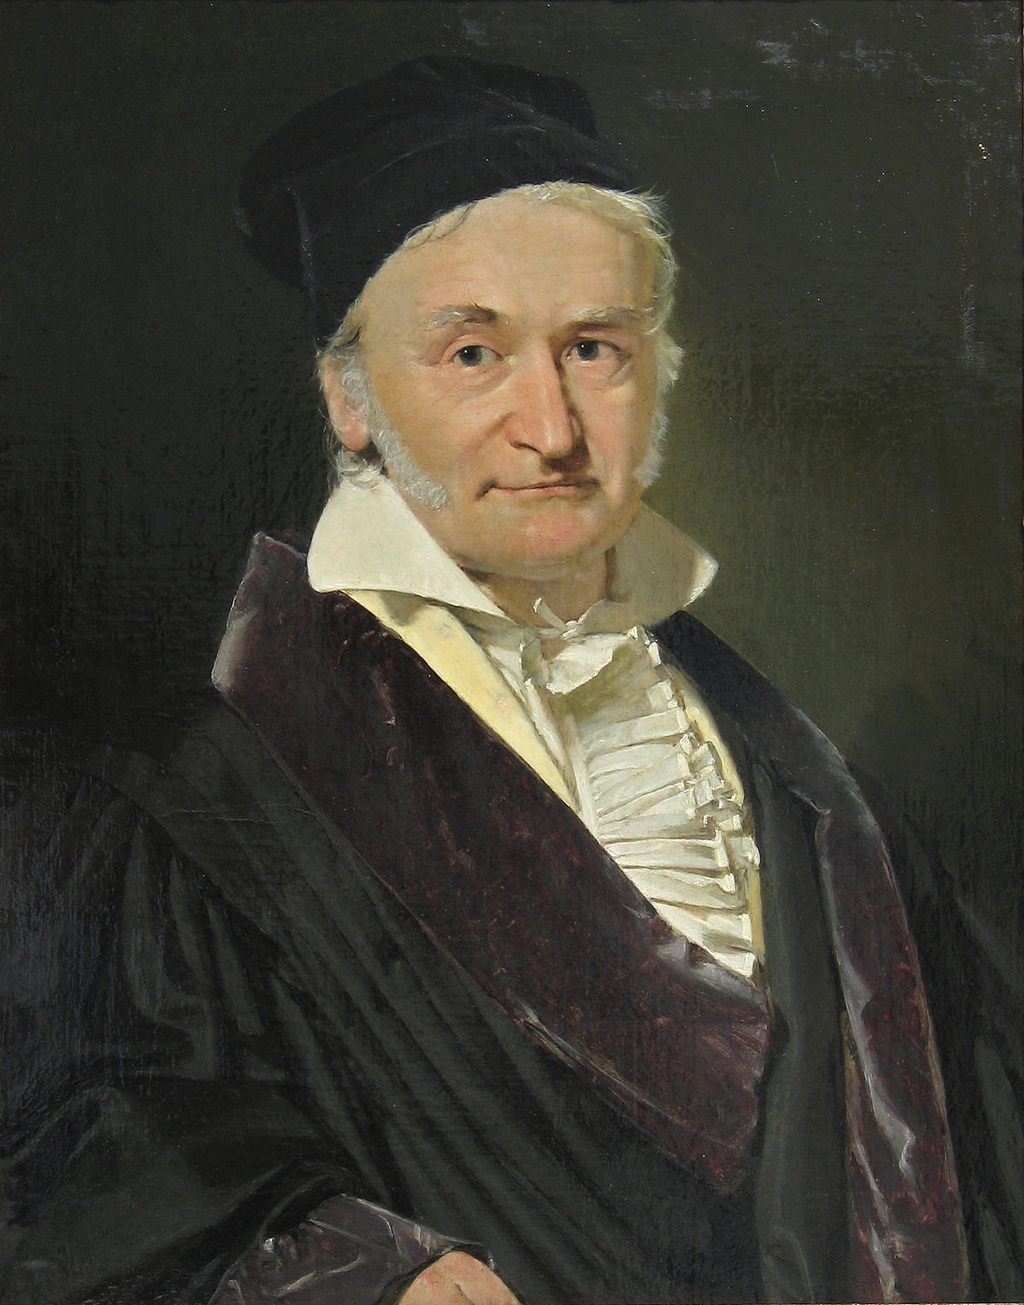
One of the earliest examples of experimental mathematics
One day in 1799, while examining tables of integrals by James Stirling…
$$\int_{0}^{1}{\frac{dt}{\sqrt{1−t^{4}}}}=\text{1}\text{.}\text{31103}$$
$$a_{n+1}=\frac{a_{n}+b_{n}}{2},b_{n+1}=\sqrt{a_{n}b_{n}}$$
$$a_{0}=1,b_{0}=\sqrt{2}$$
$$a_{n}$$
$$b_{n}$$
1, 1.20711, 1.19816, 1.19814
1.41421, 1.18921, 1.19812, 1.19814
$$\frac{1}{\text{1}\text{.}\text{19814} }=\frac{2}{π}\text{×}\text{1}\text{.}\text{31103}$$
$$\frac{1}{\lim_{n→∞}{a_{n}}}=\frac{2}{π}\int_{0}^{1}{\frac{dt}{\sqrt{1−t^{4}}}}$$
“I have the result, but I do not yet know how to get it”
⇒ elliptic and modular function theory

Slide 4
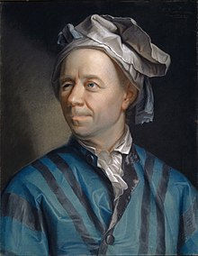
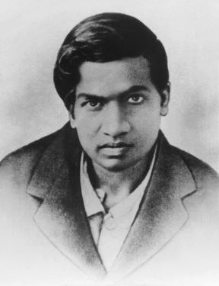
Leonhard Euler
Srinivasa Ramanujan
$$e^{\frac{2π}{8}} \sqrt{\frac{\sqrt{2}−1}{2}} =\frac{1}{1+\frac{e^{−2π}}{1+e^{−2π}+\frac{e^{−4π}}{1+e^{−4π}+…}}}$$
$$\frac{4}{π}+1=2+\frac{1^{2}}{2+\frac{3^{2}}{2+\frac{5^{2}}{2+…}}}$$

Slide 5
Be wise, generalize
Can we generalize and extract all these expressions from a unified theory?
Elimelech et al. arXiv:2308.11829 (2023)

Slide 6
Can we generalize and extract all these formulas from a unified theory?
$$\frac{4}{π}=1+\frac{1^{2}}{3+\frac{2^{2}}{5+\frac{3^{2}}{7+…}}}$$
$$\frac{2}{π−2}=1+\frac{1⋅2}{1+\frac{2⋅3}{1+\frac{3⋅4}{1+…}}}$$
$$\frac{4+π}{π}=2+\frac{1^{2}}{2+\frac{3^{2}}{2+\frac{5^{2}}{2+…}}}$$
$$\frac{4}{π−2}=3+\frac{1⋅3}{5+\frac{2⋅4}{7+\frac{3⋅5}{9+…}}}$$
$$π+3=6+\frac{1^{2}}{6+\frac{3^{2}}{6+\frac{5^{2}}{6+…}}}$$
$$\frac{π}{2}+1=3+\frac{−2⋅1⋅2+1+1}{6+\frac{−2⋅2⋅3+2+1}{9+\frac{−2⋅3⋅4+3+1}{12+…}}}$$
formulas for $π$ from hundreds of years ago
more recent formulas for $π$

Slide 7
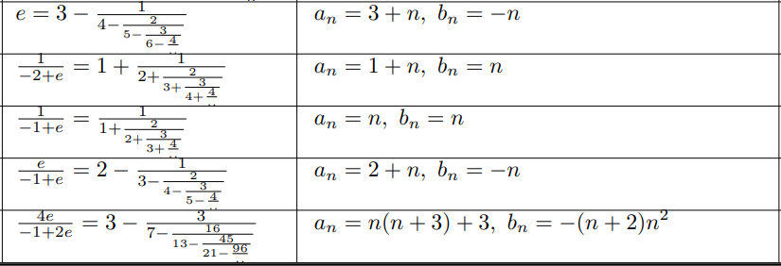
Can we generalize and extract all these formulas from a unified theory?
Looking for an underlying theory…
Can we generalize and extract all these expressions from a unified theory?

Slide 8
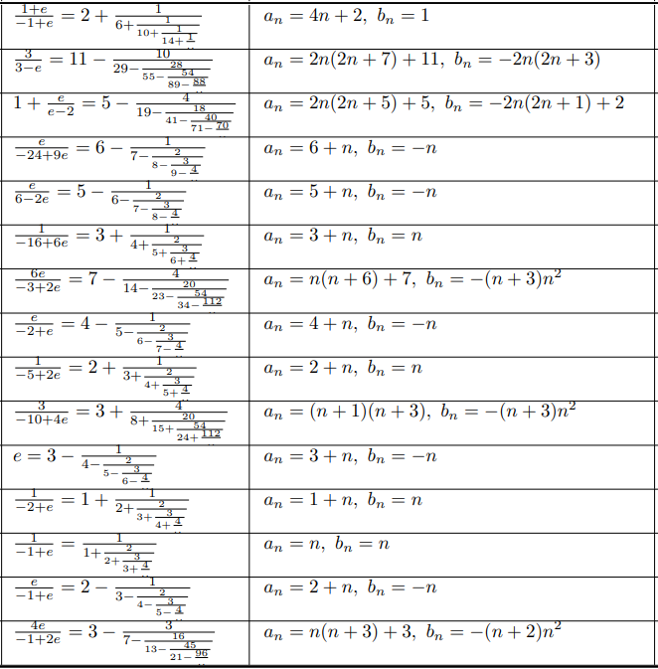
Can we generalize and extract all these formulas from a unified theory?

Slide 9
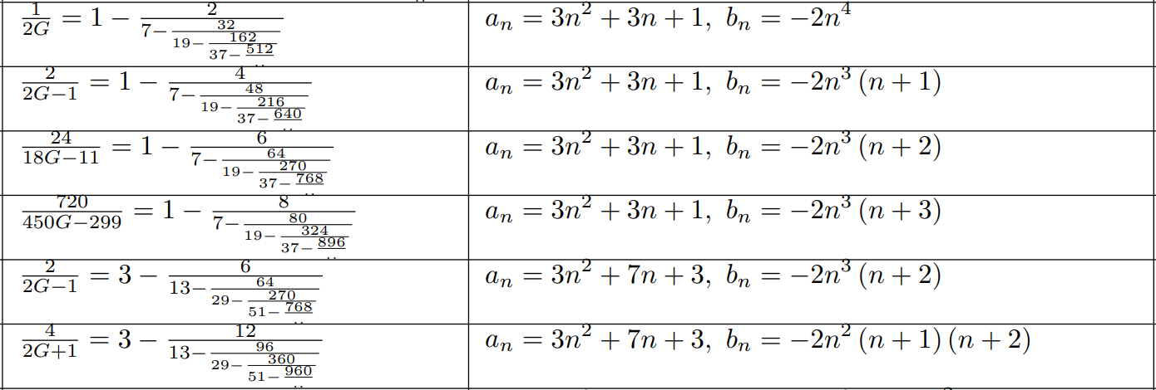
The same question arises for many mathematical constants… is there a unified theory?
G = 0.915965594177219015054603514932384110774…
$$\frac{1}{2G}=1−\frac{2×1^{4}}{7−\frac{2×2^{4}}{19−\frac{2×3^{4}}{37…−\frac{2×n^{4}}{1+3n\left(n+1\right)}}}}$$
where $β$ is the Dirichlet beta function

Slide 10
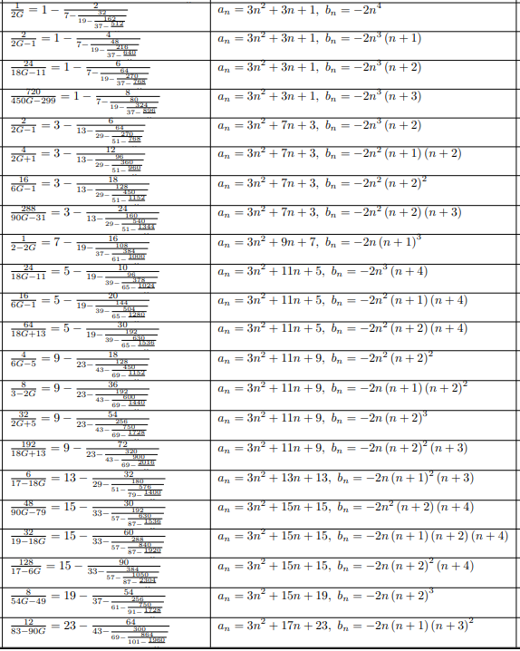
The same question arises for many mathematical constants… is there a unified theory?

Slide 11
Experimental Mathematics
Discoveries in mathematics assisted by algorithms: exploring parameter spaces that humans would take too long to investigate
Intriguing possibility: human intuition + computer algorithms ⇒ discovery of new concepts
Here we
develop a massively parallel computer algorithm
discover an unprecedented number of formulas for mathematical constants
unveil a novel mathematical structure – the conservative matrix field
Conservative matrix fields
unify thousands of existing formulas
generate infinitely many new formulas
lead to unexpected relations between different mathematical constants
enable new mathematical proofs, for example, the irrationality of ζ(3)

Slide 12
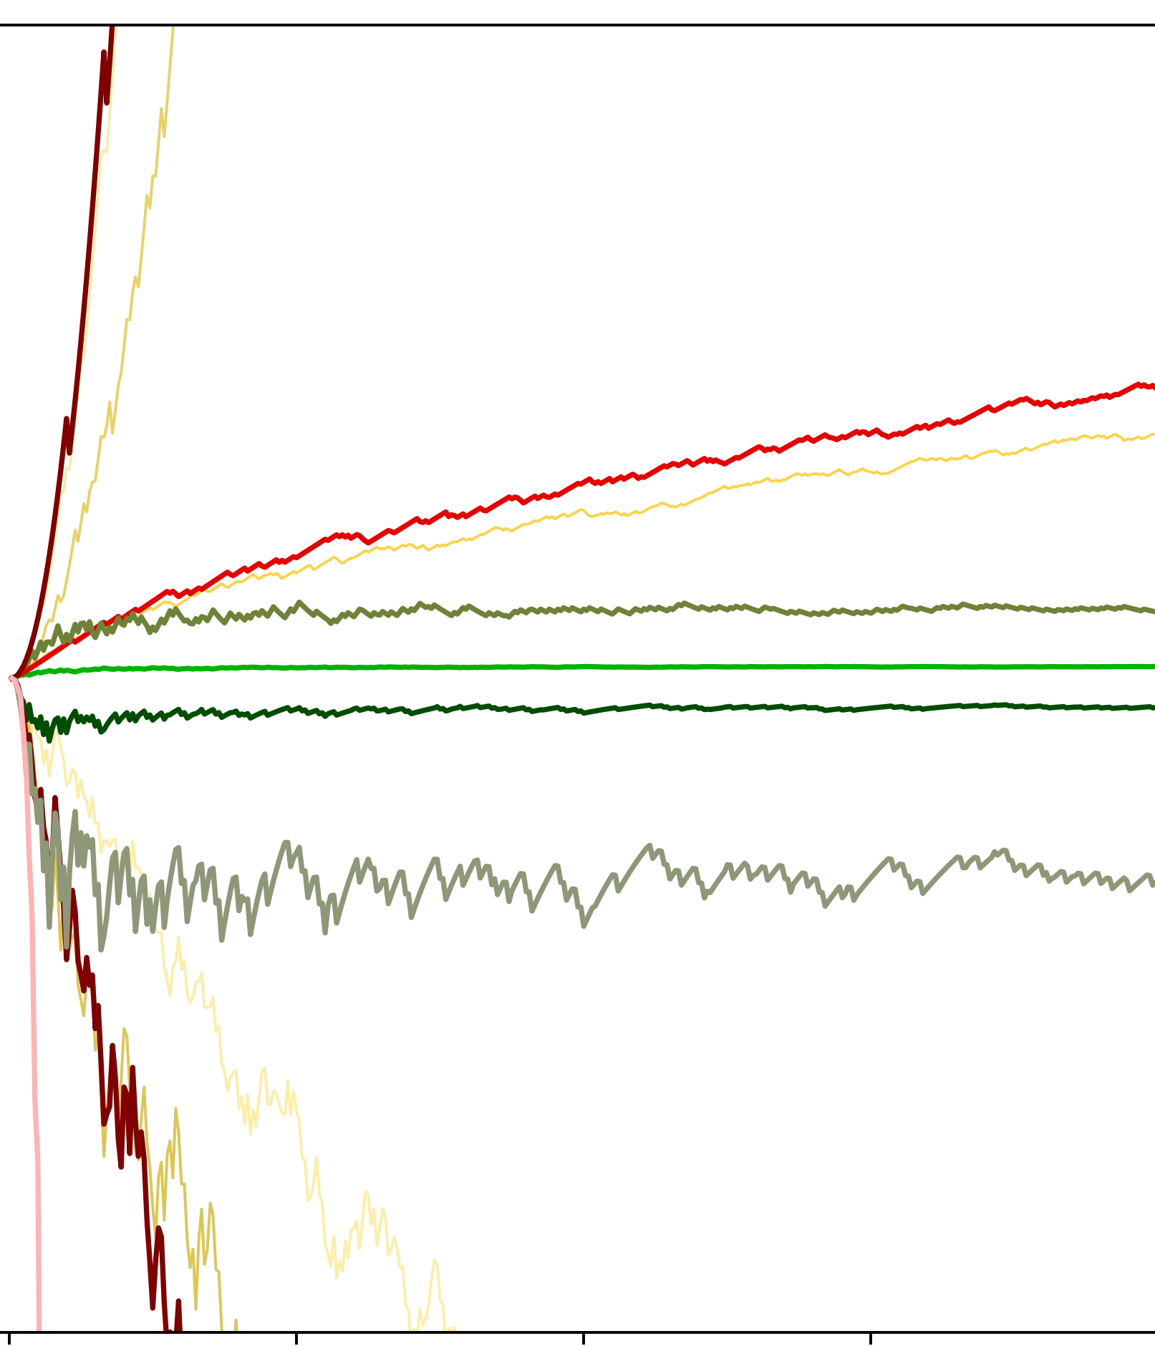
Identification of math constants using factorial reduction
The sparsity of factorial reduction (FR)
$$\sqrt[n]{p_{n}/g_{n}}$$
$$\sqrt[n]{p_{n}/g_{n}}$$
0
$$c=12, d=0$$
Has FR
400
-25000
No FR
$$c=16, d=0$$
-50000
$$c=8, d=0$$
$$d≠0$$
200
-75000
$$c=10, d=0$$
$$c=15, d=0$$
$$c=9, d=0$$
50
100
iterations $n$
150
$$G$$
continued fractions of the form:
$$a_{n}=17\left(n^{3}+{\left(n+1\right)}^{3}\right)−c\left(2n+1\right)+d b_{n}=−n^{6}$$
$$π$$
$$ζ\left(3\right)$$
Limit | FR | $$a_{n}$$ | $$b_{n}$$
$$4/π$$ |  | $$1+2n$$ | $$n^{2}$$
no closed form |  | $$4n$$ | $$n^{2}$$
$$1/G−1$$ |  | $$8n$$ | $${\left(2n−1\right)}^{4}$$
no closed form |  | $$8n+1$$ | $${\left(2n−1\right)}^{4}$$
$$1/(ζ\left(3\right)−251/216)$$ |  | $$n^{3}+{\left(n+1\right)}^{3}+24(2n+1)$$ | $$−n^{6}$$
no closed form |  | $$n^{3}+{\left(n+1\right)}^{3}+25(2n+1)$$ | $$−n^{6}$$
$$6/\hat{ζ}\left(5,1\right)$$ |  | $$n^{5}+\left(n+2\right){\left(n+1\right)}^{4}$$ | $$−n^{9}\left(n+1\right)$$
no closed form |  | $$n^{5}+\left(n+2\right){\left(n+1\right)}^{4}+n^{2}$$ | $$−n^{9}\left(n+1\right)$$
-200
$$\hat{ζ}\left(5,1\right)$$
-400
100
200
iterations $n$
300
$$\frac{6}{ζ\left(3\right)}=5+\frac{−1^{6}}{117+\frac{−2^{6}}{⋱+\frac{−n^{6}}{34n^{3}+51n^{2}+27n+5}}}$$

Slide 13
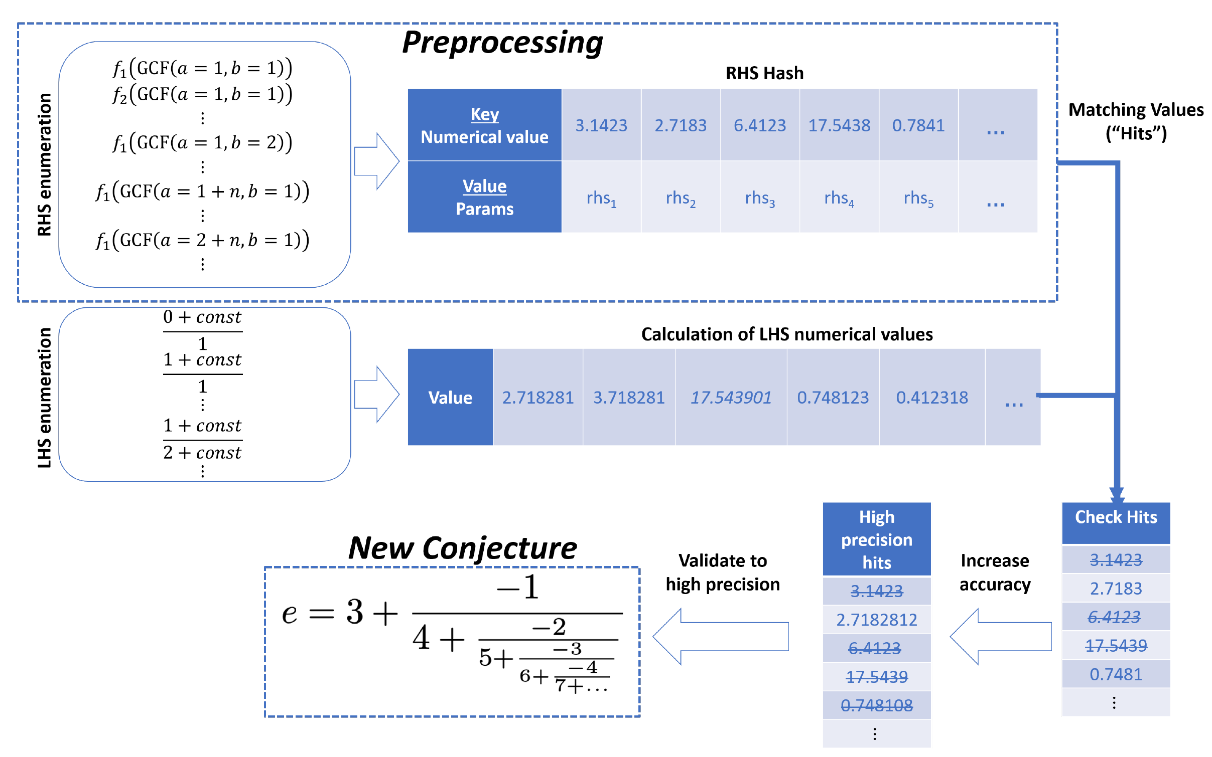
Meet-in-the-middle
Black box
$$x\overset{⇒}{?}π$$
$x\overset{⇒}{?}$ $\frac{2}{π}$
$A_{0},A_{1},A_{2}$, $B_{0},B_{1},B_{2}$
$$1/x\overset{⇒}{?}π$$
$x\overset{⇒}{?}$ $\frac{2}{π+1}$
e.g.,
$$a_{n}=A_{0}+A_{1}n+A_{2}n^{2}$$
$$b_{n}=B_{0}+B_{1}n+B_{2}n^{2}$$
$$x=a_{0}+\frac{b_{0}}{a_{1}+\frac{b_{1}}{a_{2}+\frac{b_{2}}{a_{3}+..}}}$$
$$x^{2}\overset{⇒}{?}π$$
$x\overset{⇒}{?}$ $\frac{2π}{π+1}$
…
Uri Mendlovic
(Google)
Raayoni et al. Nature 590, 67–73 (2021)

Slide 14
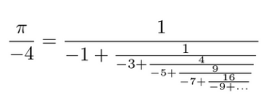
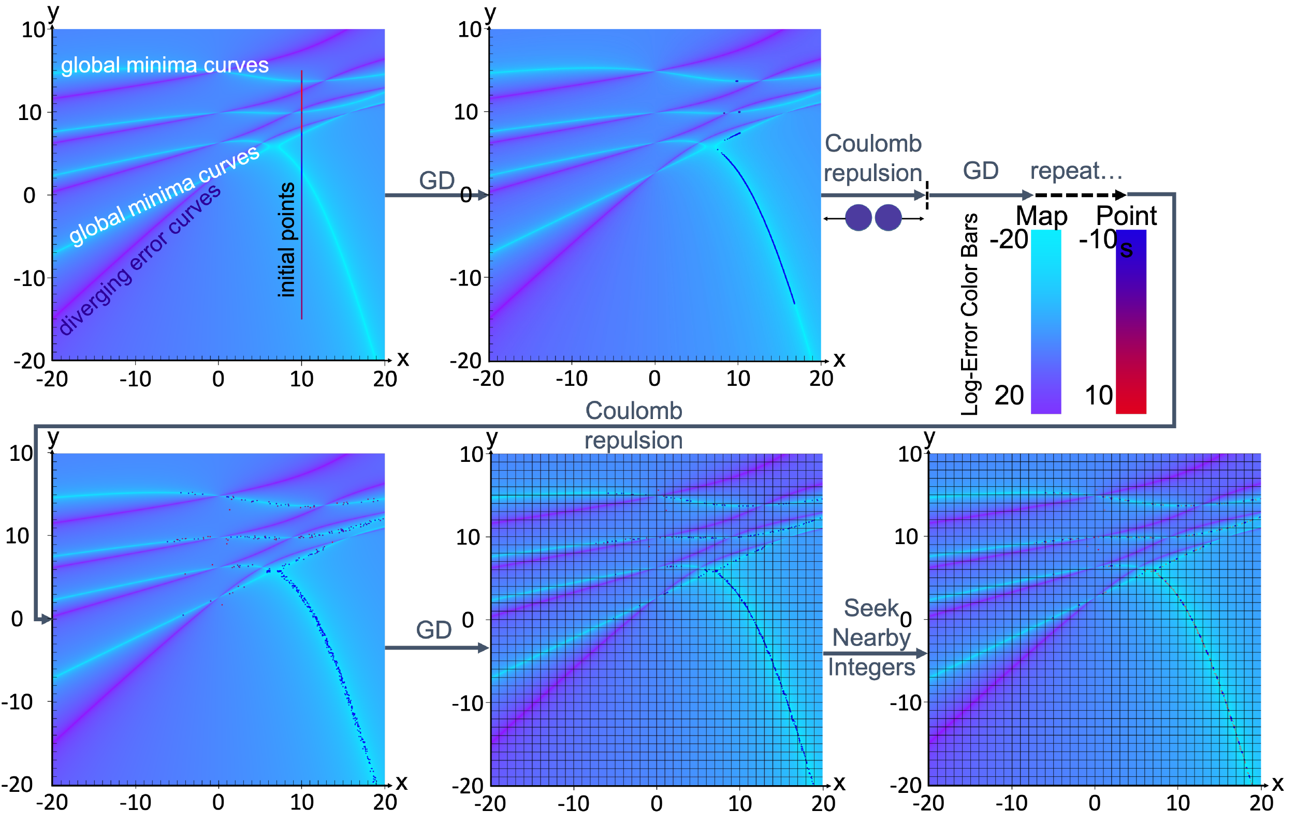
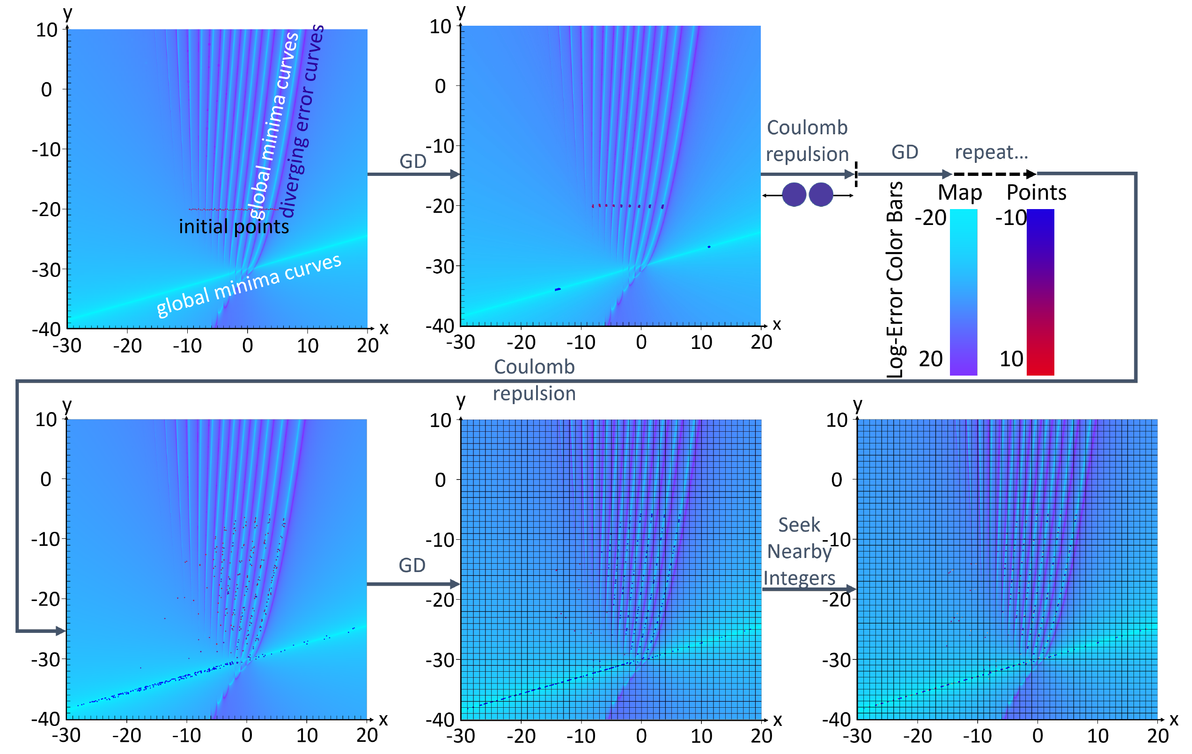
Gradient descent on recurrent formulas
x=-3,y=-2
Yahel Manor
Raayoni et al. Nature 590, 67–73 (2021)
K_n=0^\infty (n+1)^2/(yn+x)
(4/pi) - 1

Slide 15
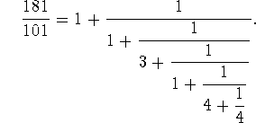
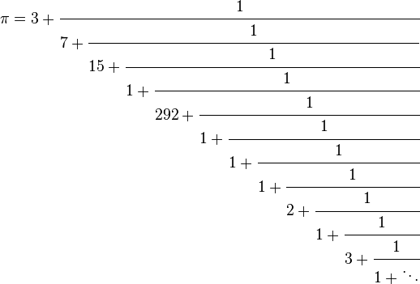
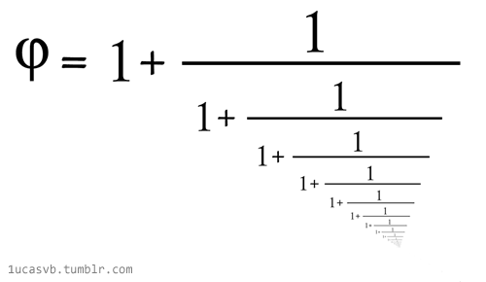
(Simple) continued fractions
$$=1.6180339887498948482…$$

Slide 16
Types of continued fractions
$$CF\left[a_{n},b_{n}\right]=$$
$$a_{0}+\frac{1}{a_{1}+\frac{1}{a_{2}+\frac{1}{a_{3}+…}}}$$
$$"b_{n}≡1"$$
$$GCF\left[a_{n},b_{n}\right]=$$
$$a_{0}+\frac{b_{1}}{a_{1}+\frac{b_{2}}{a_{2}+\frac{b_{3}}{a_{3}+…}}}$$
$a_{n},b_{n}$ are general (complex) sequences
$$PCF\left[a_{n},b_{n}\right]=$$
$$a_{0}+\frac{b_{1}}{a_{1}+\frac{b_{2}}{a_{2}+\frac{b_{3}}{a_{3}+…}}}$$
$$a_{n}=a(n)∈ℚ\left[n\right]$$
$$b_{n}=b(n)∈ℚ\left[n\right]$$
Combine a broad mathematical scope and computational simplicity

Slide 17
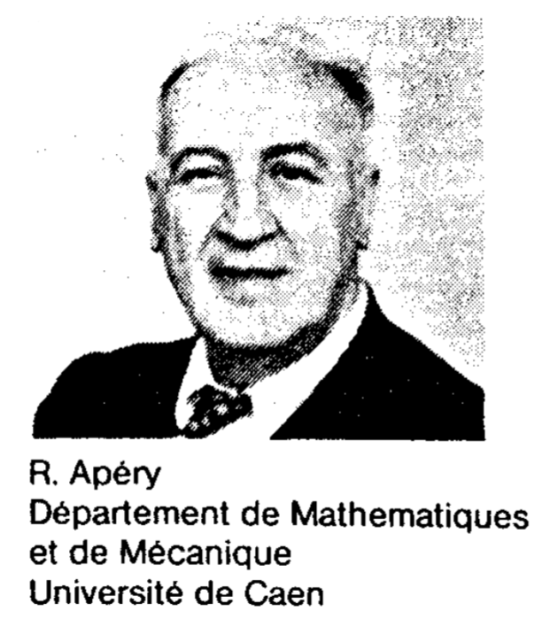
Apéry’s PCF:
Apéry’s constant
Appears in number theory and physics
Debye model and the Stefan–Boltzmann law
$$ζ\left(3\right)=\sum_{n=1}^{∞}{\frac{1}{n^{3}}}$$
=1.20205690315959428539973816151144999076…
$$\frac{6}{ζ\left(3\right)}=5+\frac{−1}{117+\frac{−64}{535+\frac{−729}{1463…+\frac{−n^{6}}{34n^{3}+51n^{2}+27n+5}}}}$$
Apéry showed that this PCF proves the irrationality of $ζ\left(3\right)$
Can we generalize his approach to other constants?

Slide 18
Recursion Formula for PCFs
$$a_{0}+\frac{b_{1}}{a_{1}+\frac{b_{2}}{a_{2}+\frac{…`}{…+\frac{b_{n}}{a_{n}}}}}=\frac{p_{n}}{q_{n}}∈ℚ$$
Both $p_{n}$ and $q_{n}$ satisfy the same recursion:
$$u_{n}=a_{n}⋅u_{n−1}+b_{n}⋅u_{n−2}$$
$$b_{n}=−n^{6}$$
$$a_{n}=34n^{3}+51n^{2}+27n+5$$

Slide 19
Irrationality criteria
Definition: The irrationality measure of $L∈ℝ$ is the largest $δ$ for which there exist a rational sequence $p_{n}/q_{n}≠L$ s.t.
$$\left|L−\frac{p_{n}}{q_{n}}\right|<\frac{1}{q_{n}^{1+δ}}.$$
Theorem (Roth’s): The irrationality measure of $L$
$$δ=\left\{\begin{aligned}0 for L rational \\ 1 for L algebric irrational \\ ≥1 for L trancdental \end{aligned}\right.$$
Conclusion: If we find even one sequence with $δ>0$ $⟹$ $L$ is irrational

Slide 20
Recursion Formula for PCFs
$$a_{0}+\frac{b_{1}}{a_{1}+\frac{b_{2}}{a_{2}+\frac{…`}{…+\frac{b_{n}}{a_{n}}}}}=\frac{p_{n}}{q_{n}}∈ℚ$$
Both $p_{n}$ and $q_{n}$ satisfy the same recursion:
$$u_{n}=a_{n}⋅u_{n−1}+b_{n}⋅u_{n−2}$$
$$b_{n}=−n^{6}$$
$$a_{n}=34n^{3}+51n^{2}+27n+5$$
$$δ=0.08$$

Slide 21
Factorial Reduction
$n=1$
$n=5$
$n=10$
$n=15$
$\frac{4}{π}=1+\frac{1^{2}}{3+\frac{2^{2}}{5+\frac{3^{2}}{7+⋱}}}$
$\frac{4}{3}$
$\frac{29520}{23184}$
$\frac{100370793600}{78831037440}$
$\frac{3594206259195552000}{2822882994841190400}$
Common divider:
$1$
$144$
$5760$
$3628800$
$\sim n!$
“Factorial reduction”
Not related to fundamental constants
$1+\frac{1^{2}}{4+\frac{2^{2}}{7+\frac{3^{2}}{10+⋱}}}$
$\frac{5}{4}$
$\frac{111339}{91140}$
$\frac{1666739432511}{1364364406260}$
$\frac{271449448302221139249}{222203877902013035340}$
Common divider:
$1$
$3$
$9$
$1053$
No factorial reduction
Has factorial reduction $⇔\sqrt[n]{p_{n}/{GCD}_{n}}$ convergences
$$to s$$
Ben David et al. arXiv 2111.04468 (2021)

Slide 22
Which PCFs have FR?
“The miracle of FR”
Extremely rare in random PCFs
Appears in all historical PCF examples
Appears in all the PCFs that we found to express mathematical constants
Open question: what PCFs have FR? How to identify them in advance?
Nadav Ben David
Guy Nimri
Ben David et al. arXiv 2111.04468 (2021)

Slide 23
A formula for δ
Generalizing Apéry
Theorem: Assuming FR, the largest $δ$ that a PCF can provide is
$$δ=\frac{\ln\left|α_{1}/α_{2}\right|}{\ln{s}}−1$$
$α_{1}>α_{2}$ are the roots of $x^{2}=Ax+B$
$A,B$ a$re the leading coefficients of a_{n},b_{n}$ respectively
$\sqrt[n]{p_{n}/{GCD}_{n}}→s$ (factorial reduction)

Slide 24
Take-home messages
For centuries, discoveries of formulas for mathematical constants have been acts of ingenuity, creativity
Experimental mathematics enables novel approach for mathematical research
Algorithm-driven, massive parallel, community of volunteers
Discovery of a new mathematical structure
An underlying hierarchy for constants
Open problems – help us!
Soon: the “arXiv” of fundamental constants and their relations

Slide 25
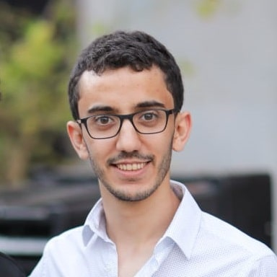
Scheme Creation
Result Verification
Formulas from the literature
Formulas Database
On-Site
Past results
New results
Rotem Elimelech
Next Search Space
Formulas Candidates
Resource Manager Server
Off-Site
Volunteer Network
Elimelech et al. arXiv:2308.11829 (2023)

Slide 26
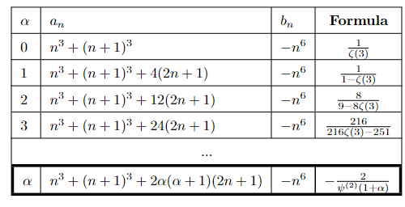
BOINC Results
* FR+PSLQ
Elimelech et al. arXiv:2308.11829 (2023)

Slide 27
Take-home messages
For centuries, discoveries of formulas for mathematical constants have been acts of ingenuity, creativity
Experimental mathematics enables novel approach for mathematical research
Algorithm-driven, massive parallel, community of volunteers
Discovery of a new mathematical structure
An underlying hierarchy for constants
Open problems – help us!
Soon: the “arXiv” of fundamental constants and their relations

Slide 29
Can we generalize and extract all these formulas from a unified theory?
Looking for an underlying theory…
Can we generalize and extract all these expressions from a unified theory?

Slide 30
Can we generalize and extract all these formulas from a unified theory?

Slide 31
Recursion Formula for PCFs
$$a_{0}+\frac{b_{1}}{a_{1}+\frac{b_{2}}{a_{2}+\frac{…`}{…+\frac{b_{n}}{a_{n}}}}}=\frac{p_{n}}{q_{n}}∈ℚ$$
Both $p_{n}$ and $q_{n}$ satisfy the same recursion:
$$u_{n}=a_{n}⋅u_{n−1}+b_{n}⋅u_{n−2}$$
$$b_{n}=−n^{6}$$
$$a_{n}=34n^{3}+51n^{2}+27n+5$$
$$\left(\begin{matrix}0 & −n^{6} \\ 1 & 34n^{3}+51n^{2}+27n+5\end{matrix}\right)$$
$$\left(\begin{matrix}0 & −n^{3} \\ {\left(n+1\right)}^{3} & 34n^{3}+51n^{2}+27n+5\end{matrix}\right)$$
$$δ=0.08$$

Slide 32
Conservative Matrix Field
Elimelech et al. arXiv:2308.11829 (2023)
$$(1)$$
$$(2)$$
$$(x,y+1)$$
$$M_{X}(x,y+1)$$
$$(x+1,y+1)$$
$$M_{Y}(x,y)$$
$$M_{Y}(x+1,y)$$
$$(x,y)$$
$$M_{X}(x,y)$$
$$(x+1,y)$$
$$M_{X}\left(x,y\right)M_{Y}\left(x+1,y\right)=M_{Y}\left(x,y\right)M_{X}\left(x,y+1\right)$$
$$(3)$$

Slide 33
Conservative Vector Field
Elimelech et al. arXiv:2308.11829 (2023)
$$\vec{F}=F_{X}\left(x,y\right)\hat{x}+F_{Y}\left(x,y\right)\hat{y}$$
$$\left(x+dl,y+dl\right)$$
$$dl$$
$$\left(x,y\right)$$
$$dl$$
+
$$F_{x}\left(x,y\right)+F_{y}\left(x+dl,y\right)=F_{Y}\left(x,y\right)+F_{X}\left(x,y+dl\right)$$

Slide 34
$$M_{x}\left(x,y\right)=\left[\begin{matrix}1 & −y−1 \\ −1 & x+y+2\end{matrix}\right]$$
$$M_{y}\left(x,y\right)=\left[\begin{matrix}0 & −y−1 \\ −1 & x+y+1\end{matrix}\right]$$
Conservative Matrix Field
Elimelech et al. arXiv:2308.11829 (2023)
$$(1)$$
$$(2)$$
$$(x,y+1)$$
$$M_{X}(x,y+1)$$
$$(x+1,y+1)$$
$$M_{Y}(x,y)$$
$$M_{Y}(x+1,y)$$
$$(x,y)$$
$$M_{X}(x,y)$$
$$(x+1,y)$$
$$M_{X}\left(x,y\right)M_{Y}\left(x+1,y\right)=M_{Y}\left(x,y\right)M_{X}\left(x,y+1\right)$$
$$(3)$$
$$\left(1\right) \frac{1}{e−1}=\frac{1}{1+\frac{2}{2+\frac{3}{3+⋱}}}$$
$$\left(2\right) \frac{1}{e−1}=1/2+\frac{1/2}{6+\frac{1}{10+\frac{1}{14+⋱}}}$$
$$\left(3\right) \frac{1}{e−1}=1−\frac{1}{3−\frac{2}{4−\frac{3}{5−⋱}}}$$
Slow convergence
Fast convergence
Slow convergence

Slide 35
$$M_{x}\left(x,y\right)=\left[\begin{matrix}1 & −y−1 \\ −1 & x+y+2\end{matrix}\right]$$
$$M_{y}\left(x,y\right)=\left[\begin{matrix}0 & −y−1 \\ −1 & x+y+1\end{matrix}\right]$$
https://www.youtube.com/watch?v=yxJa8NfQK6g&ab_channel=RamanujanMachine

Slide 36
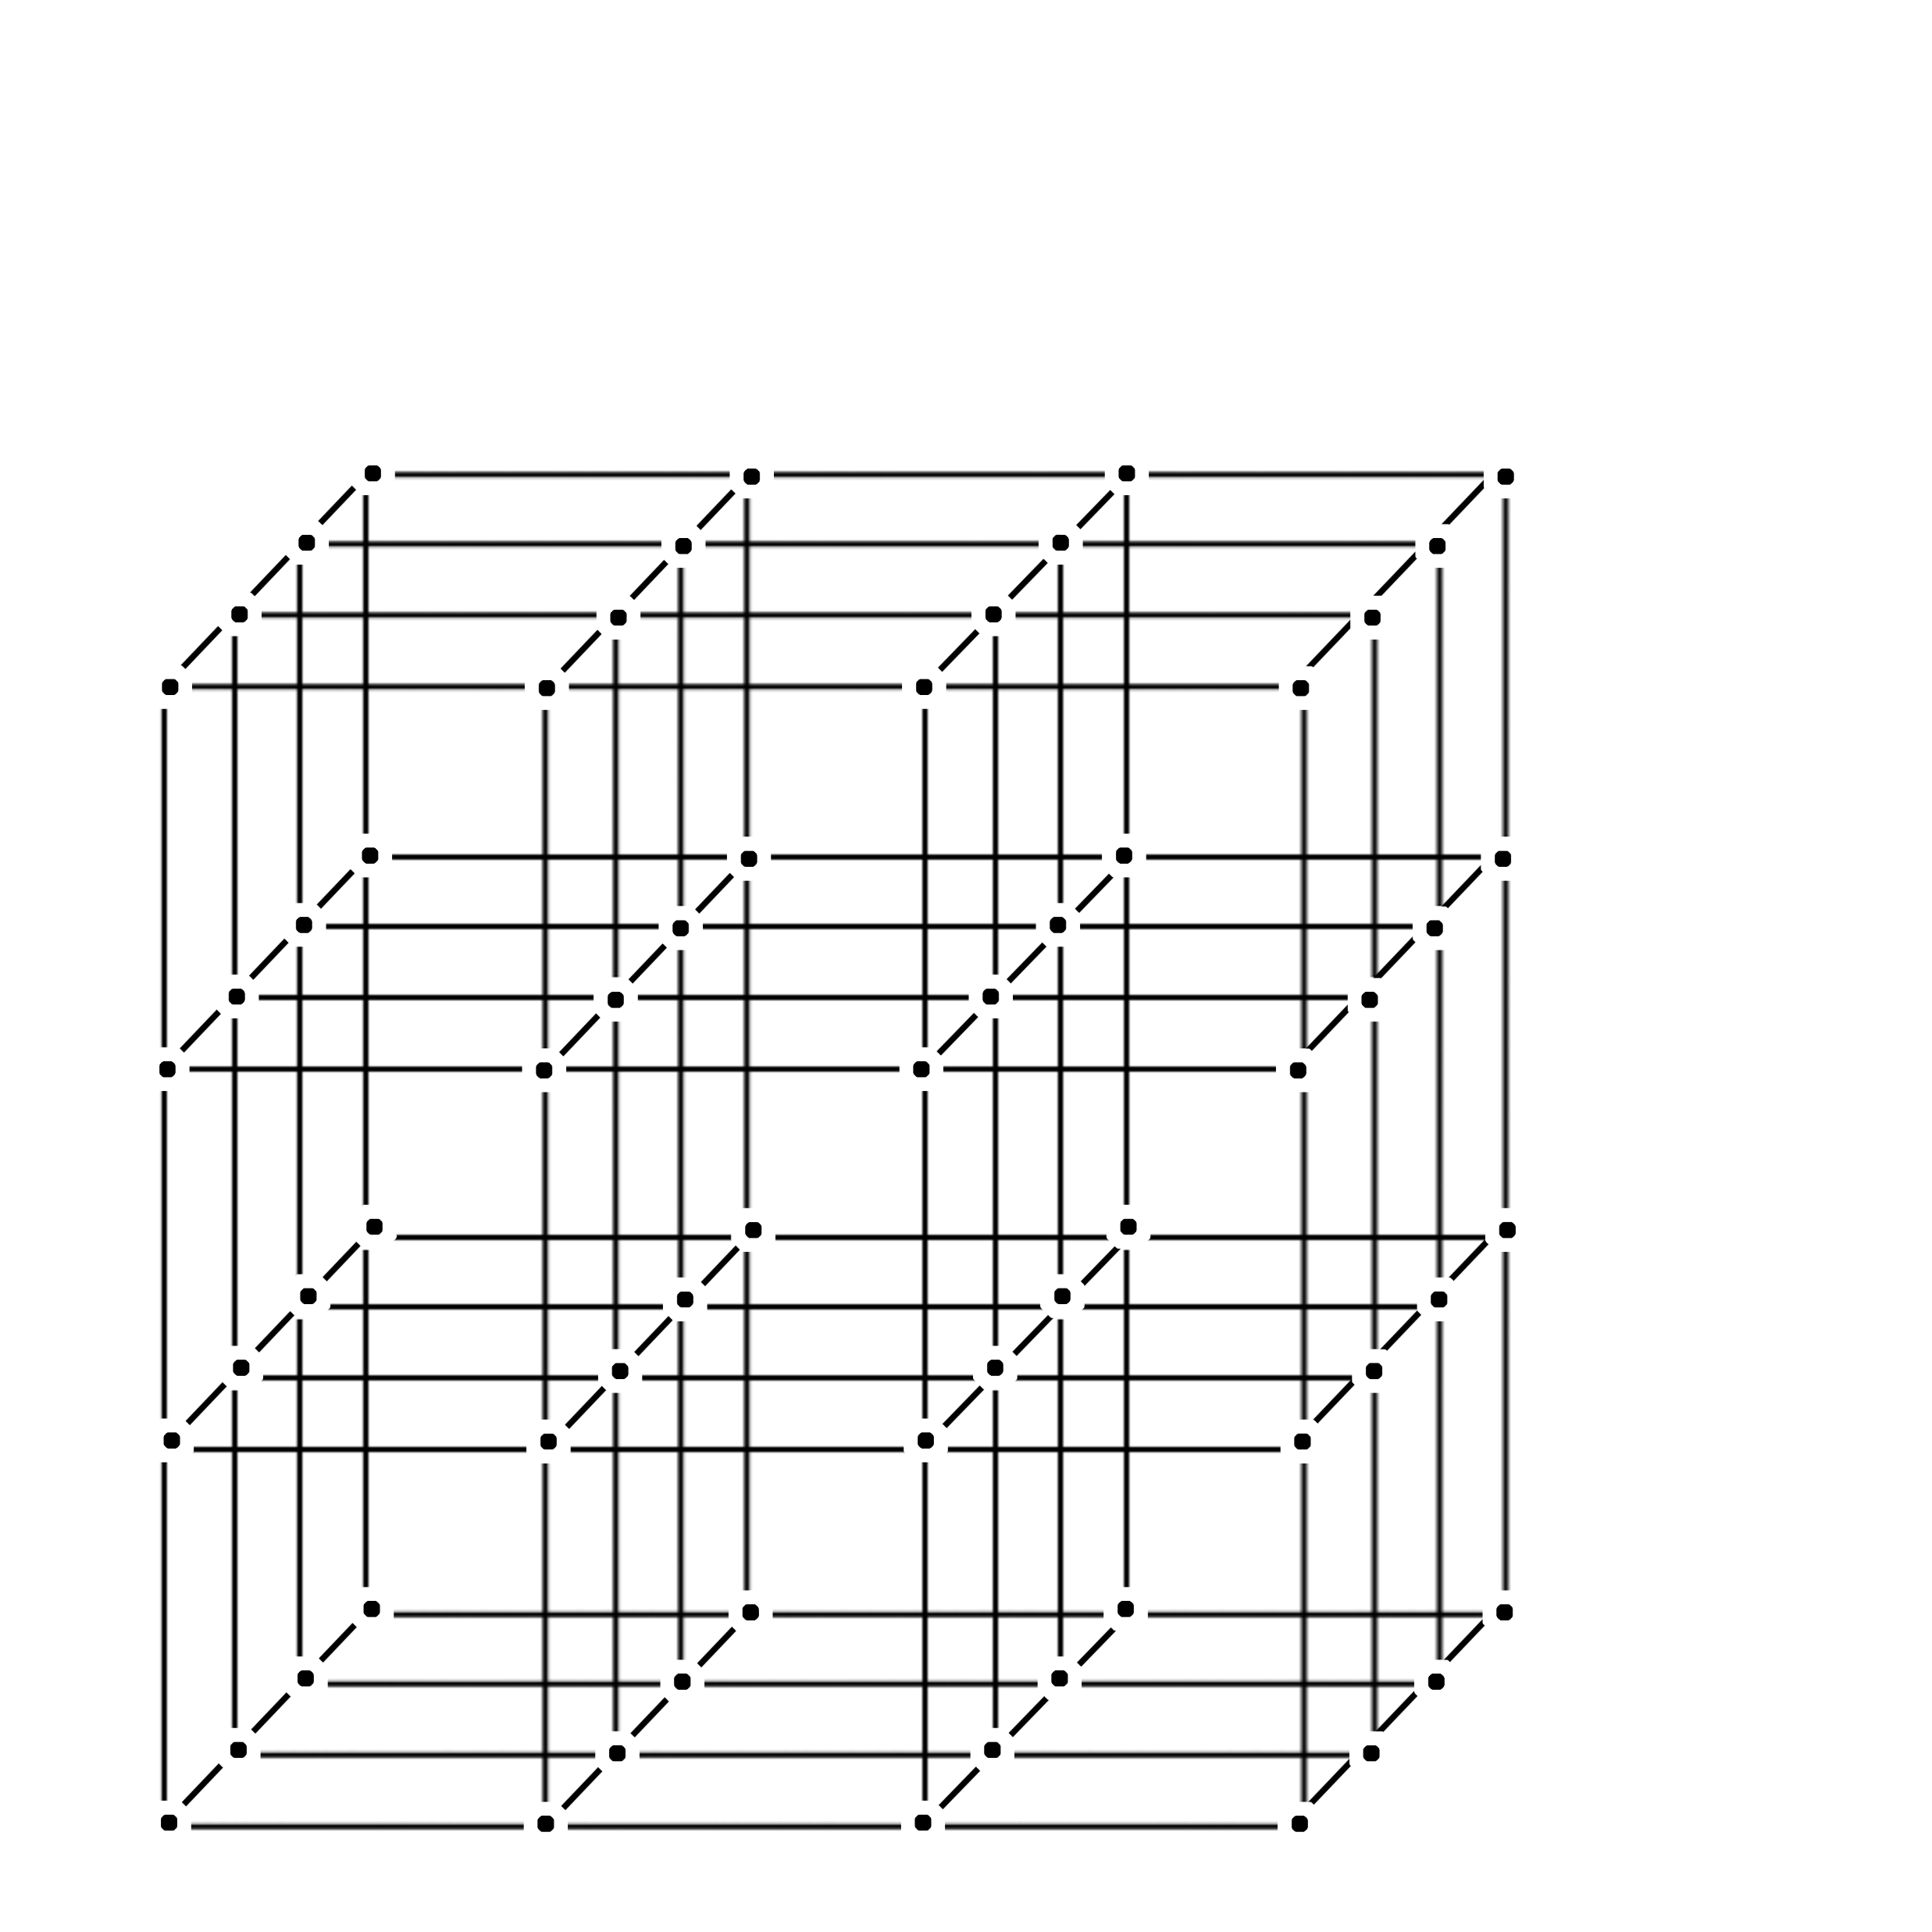
Multi-dimensional CMF
$$C_{2}$$
$$R_{3,3,3}=R_{3,3,2}⋅C_{3}\left(3,3,2\right)$$
$$C_{3}\left(3,3,2\right)$$
$$R_{3,3,2}=R_{3,3,1}⋅C_{3}\left(3,3,1\right)$$
$$C_{3}\left(3,3,1\right)$$
$$R_{3,3,1}=R_{3,3,0}⋅C_{3}\left(3,3,0\right)$$
$$C_{3}\left(3,3,0\right)$$
$$R_{3,3,0}=R_{3,2,0}⋅C_{2}\left(3,2,0\right)$$
$$C_{1}(1,3,0)$$
$$C_{2}\left(1,2,0\right)⋅C_{1}\left(1,3,0\right)=C_{1}(1,2,0)⋅C_{2}(2,2,0)$$
$$C_{2}(1,2,0)$$
$$C_{2}(2,2,0)$$
$$C_{2}\left(3,2,0\right)$$
$$C_{1}(1,2,0)$$
$$R_{3,2,0}=R_{3,1,0}⋅C_{2}\left(3,1,0\right)$$
$$C_{2}\left(3,1,0\right)$$
$$C_{3}$$
$$R_{3,1,0}=R_{3,0,0}⋅C_{2}\left(3,0,0\right)$$
$$C_{2}\left(3,0,0\right)$$
Origin
$$C_{1}\left(0,0,0\right)$$
$$C_{1}\left(1,0,0\right)$$
$$C_{1}\left(2,0,0\right)$$
$$C_{1}$$
$$R_{0,0,0}$$
$$R_{1,0,0}=R_{0,0,0}⋅C_{1}\left(0,0,0\right)$$
$$R_{2,0,0}=R_{1,0,0}⋅C_{1}\left(1,0,0\right)$$
$$R_{3,0,0}=R_{2,0,0}⋅C_{1}\left(2,0,0\right)$$

Slide 37
Can we generalize and extract all these formulas from a unified theory?
$$\frac{4}{π}=1+\frac{1^{2}}{3+\frac{2^{2}}{5+\frac{3^{2}}{7+…}}}$$
$$\frac{2}{π−2}=1+\frac{1⋅2}{1+\frac{2⋅3}{1+\frac{3⋅4}{1+…}}}$$
$$\frac{4+π}{π}=2+\frac{1^{2}}{2+\frac{3^{2}}{2+\frac{5^{2}}{2+…}}}$$
$$\frac{4}{π−2}=3+\frac{1⋅3}{5+\frac{2⋅4}{7+\frac{3⋅5}{9+…}}}$$
$$π+3=6+\frac{1^{2}}{6+\frac{3^{2}}{6+\frac{5^{2}}{6+…}}}$$
$$\frac{π}{2}+1=3+\frac{−2⋅1⋅2+1+1}{6+\frac{−2⋅2⋅3+2+1}{9+\frac{−2⋅3⋅4+3+1}{12+…}}}$$
formulas for $π$ from hundreds of years ago
more recent formulas for $π$

Slide 38
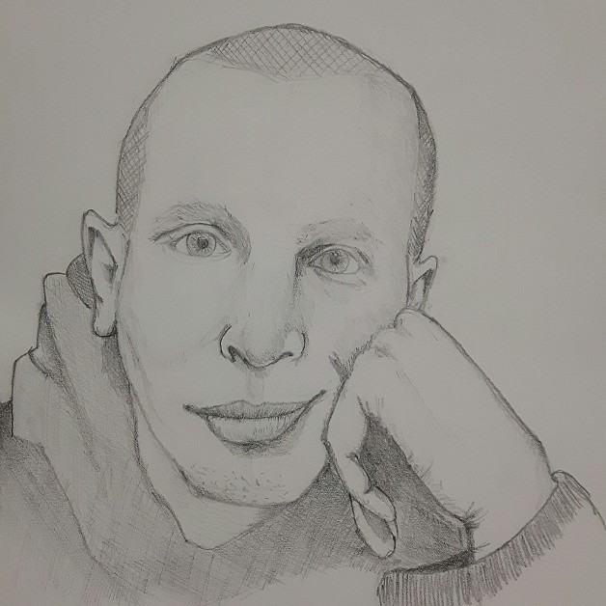
2D CMF of $ζ(3)$
Slow convergence
Fast convergence
proves the irrationality of Zeta[3]
David, arXiv 2303.09318 (2023)
Can you generalize it?
Find such a CMF for 𝜁(5)
Ofir David
Slow convergence

Slide 39
A formula for δ
Generalizing Apéry to CMFs
Conjecture: Every CMF provides a $δ$ along each trajectory:
$$δ=\frac{\ln{(α_{1}/α_{2}) }}{\ln{s}}−1$$
$α_{1}>α_{2}$ are the eigenvalues of $the matrix along the trajectory$
$\sqrt[n]{M_{n}^{11}/{GCD}_{n}}→s$ (factorial reduction on the entire matrix)

Slide 40
What we know and what we guess about CMFs
Connection between constants
$π^{2}$ and $G$
$π$ and $\sqrt{2}$
$e$ and $δ$ (Gompertz)
Hierarchy
Factorial reduction ⇔ CMFs?
Convergence to the same constant along different trajectories?
Elimelech et al. arXiv:2308.11829 (2023)

Slide 41
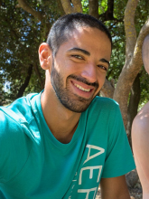
Open Questions: math\algo
Prove that ALL the PCFs of $π$ are made from one CMF
Find the best irrationality measure given by a known CMF
Algorithms for finding a continued fraction inside a CMF
Finding an efficient way to calculate the “potential” of a CMF
Reduce the factorial part
Generalize the CMF to larger matrices or to different fields
Find the CMF of zeta(5)
New clues
How many dimensions are in the CMF of each constant?
Are there CMFs for any polynomial degree?
A new search algorithm to find CMFs
Michael Shalyt
Carlos De la Cruz
Rotem Kalisch
Eyal Kalman

Slide 42
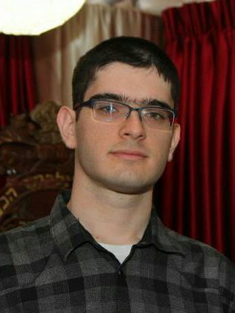
Take-home messages
For centuries, discoveries of formulas for mathematical constants have been acts of ingenuity, creativity
Experimental mathematics enables novel approach for mathematical research
Algorithm-driven, massive parallel, community of volunteers
Discovery of a new mathematical structure
An underlying hierarchy for constants
Open problems – help us!
Soon: the “arXiv” of fundamental constants and their relations
Itay Beit-Halachmi

Slide 43
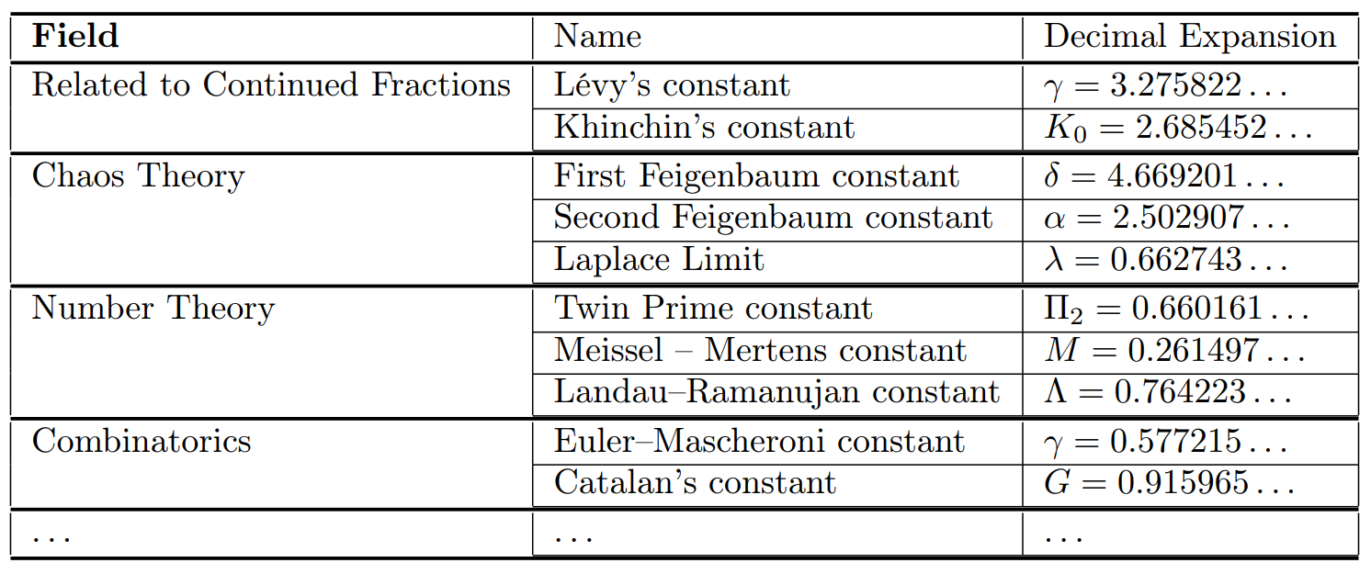
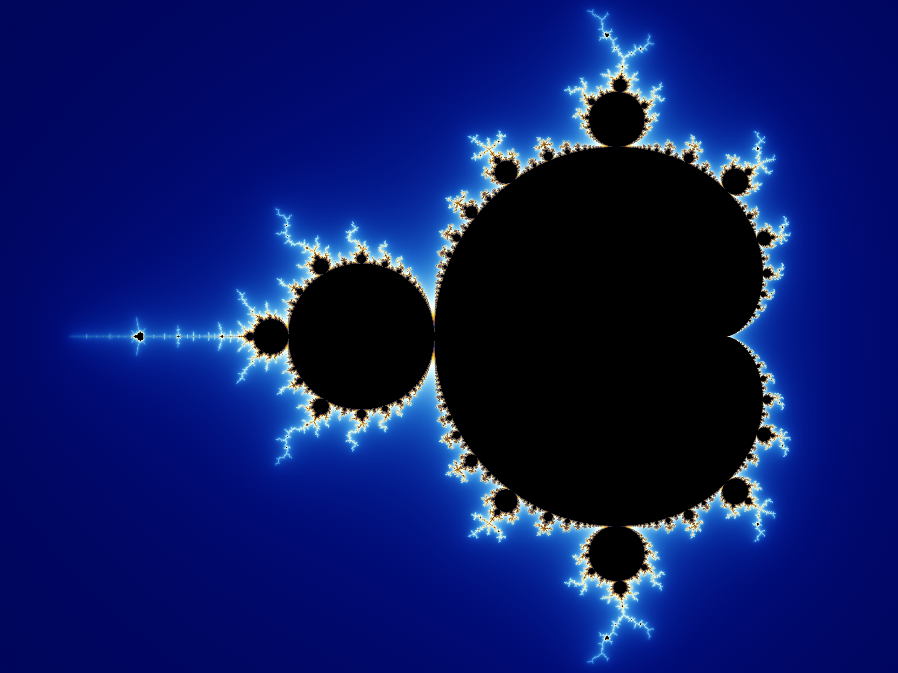
Can we find similar structures for constants in other fields of science?
Open questions in chaos theory
Feigenbaum’s constants appear in problems of fluid-flow turbulence, electronic oscillators, chemical reactions, and even in the Mandelbrot set

Slide 44
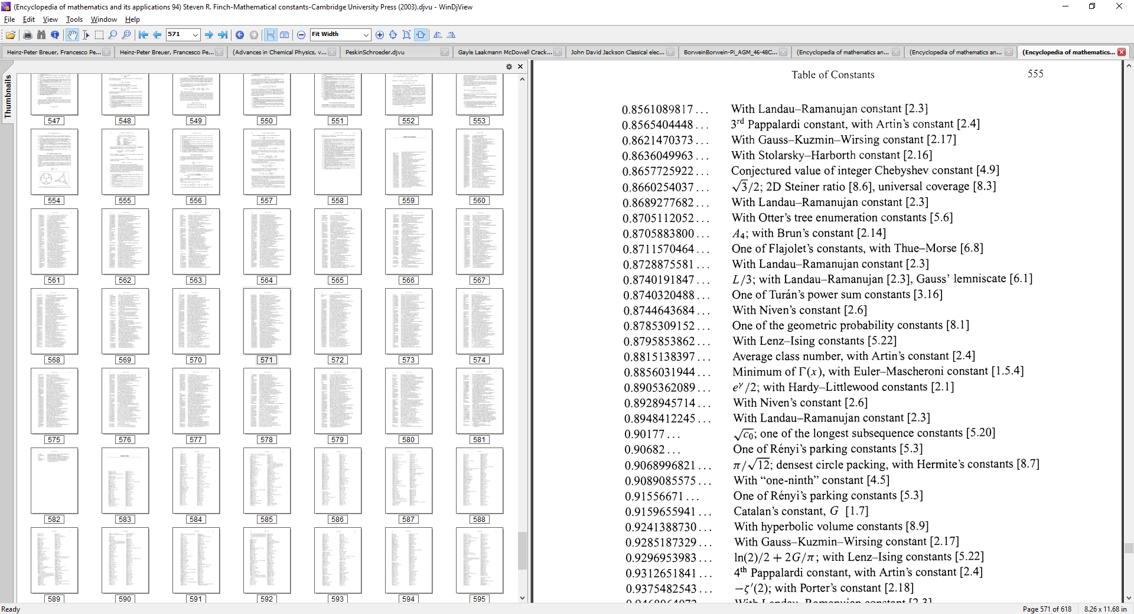
Mathematical constants appear in many fields of science
Constants provide an absolute ground truth, with unlimited amounts of data
Mathematical Constants, Steven R. Finch (Cambridge University Press, 2003)
Encyclopedia of Mathematics and its Applications; v. 94

Slide 45
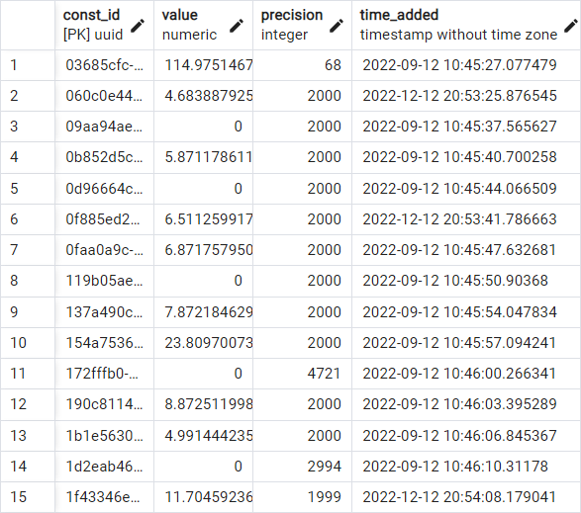
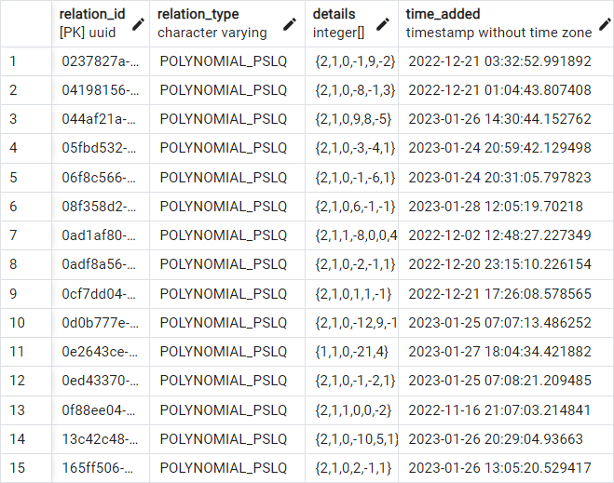
Library of Integer Relations and Constants
Publicly accessible
Convenient interface
$$a_{1}x_{1}+a_{2}x_{2}+…+a_{n}x_{n}=0$$
Beit-Halachmi et al. in preparation

Slide 46
Take-home messages
For centuries, discoveries of formulas for mathematical constants have been acts of ingenuity, creativity
Experimental mathematics enables novel approach for mathematical research
Algorithm-driven, massive parallel, community of volunteers
Discovery of a new mathematical structure
An underlying hierarchy for constants
Open problems – help us!
Soon: the “arXiv” of fundamental constants and their relations

Slide 47
Backup Slides

Slide 48
Simple known relations about CLs
The rate of convergence when going along a certain direction in a CL is the maximal eigenvalue of the matrix that represents the direction (looking at the leading coefficients of the matrix).
The irrationality constant that results from a certain direction is
$$δ=\frac{\ln{λ}−\ln{e_{min }}}{\ln{e_{max }}−\ln{λ}}=\frac{\ln\left(e_{max}/e_{min }\right)}{\ln{s}}−1$$
With $e_{min },e_{max }$ being the eigenvalues of the matrix.
We found that we always have $λ<e_{max }$. When $λ=e_{max }$, then the direction in the CL proves that the constant is a Liouville number.
When $e_{min}<λ$, then $δ>0$ and the direction in the CL proves irrationality.

Slide 49
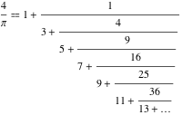
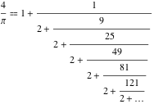
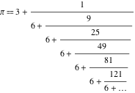
Automatic harvesting of the scientific literature
arXiv = open repository of scientific literature
1.85M papers
Millions of formulas
Clusters of similar formulas
Generalizing mathematical structures that will be explored by algorithms

Slide 50
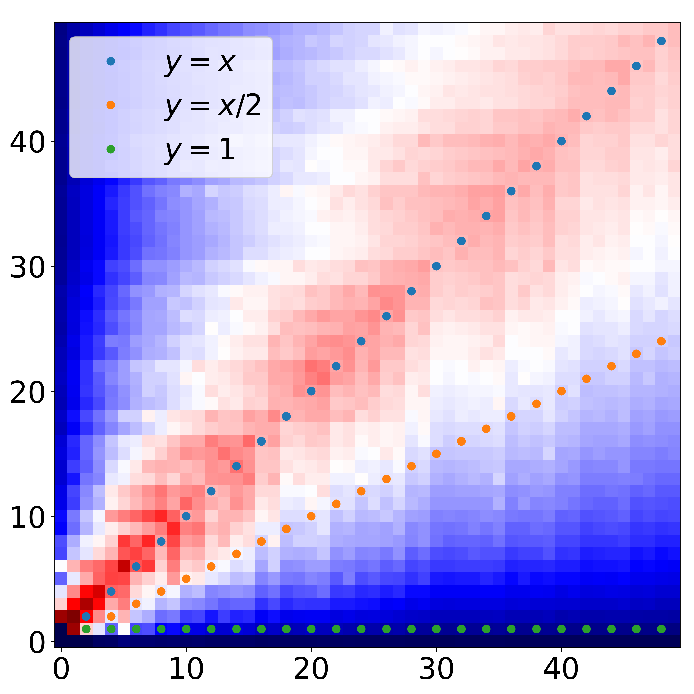
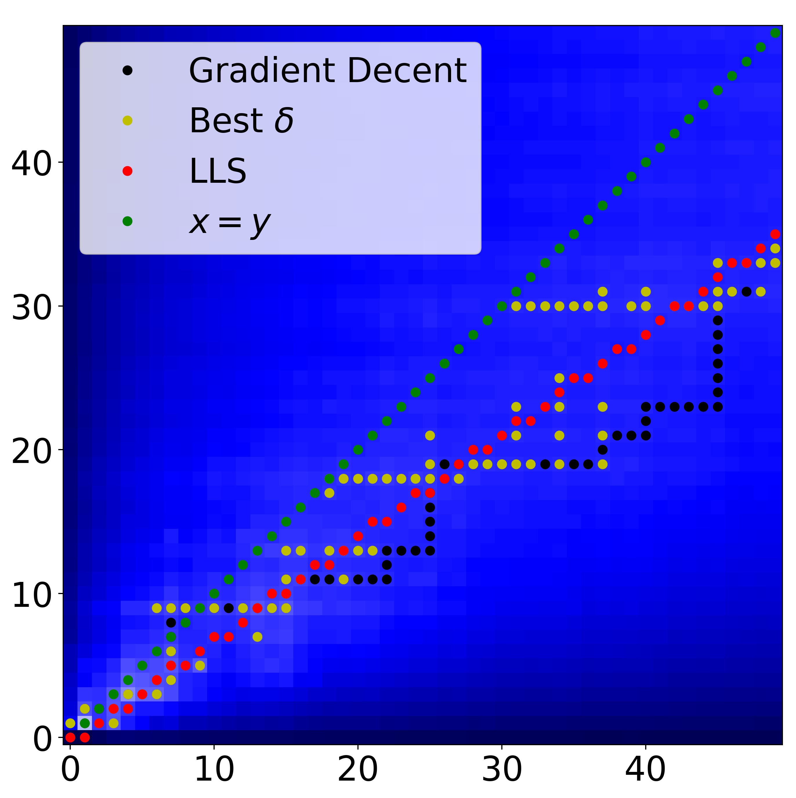
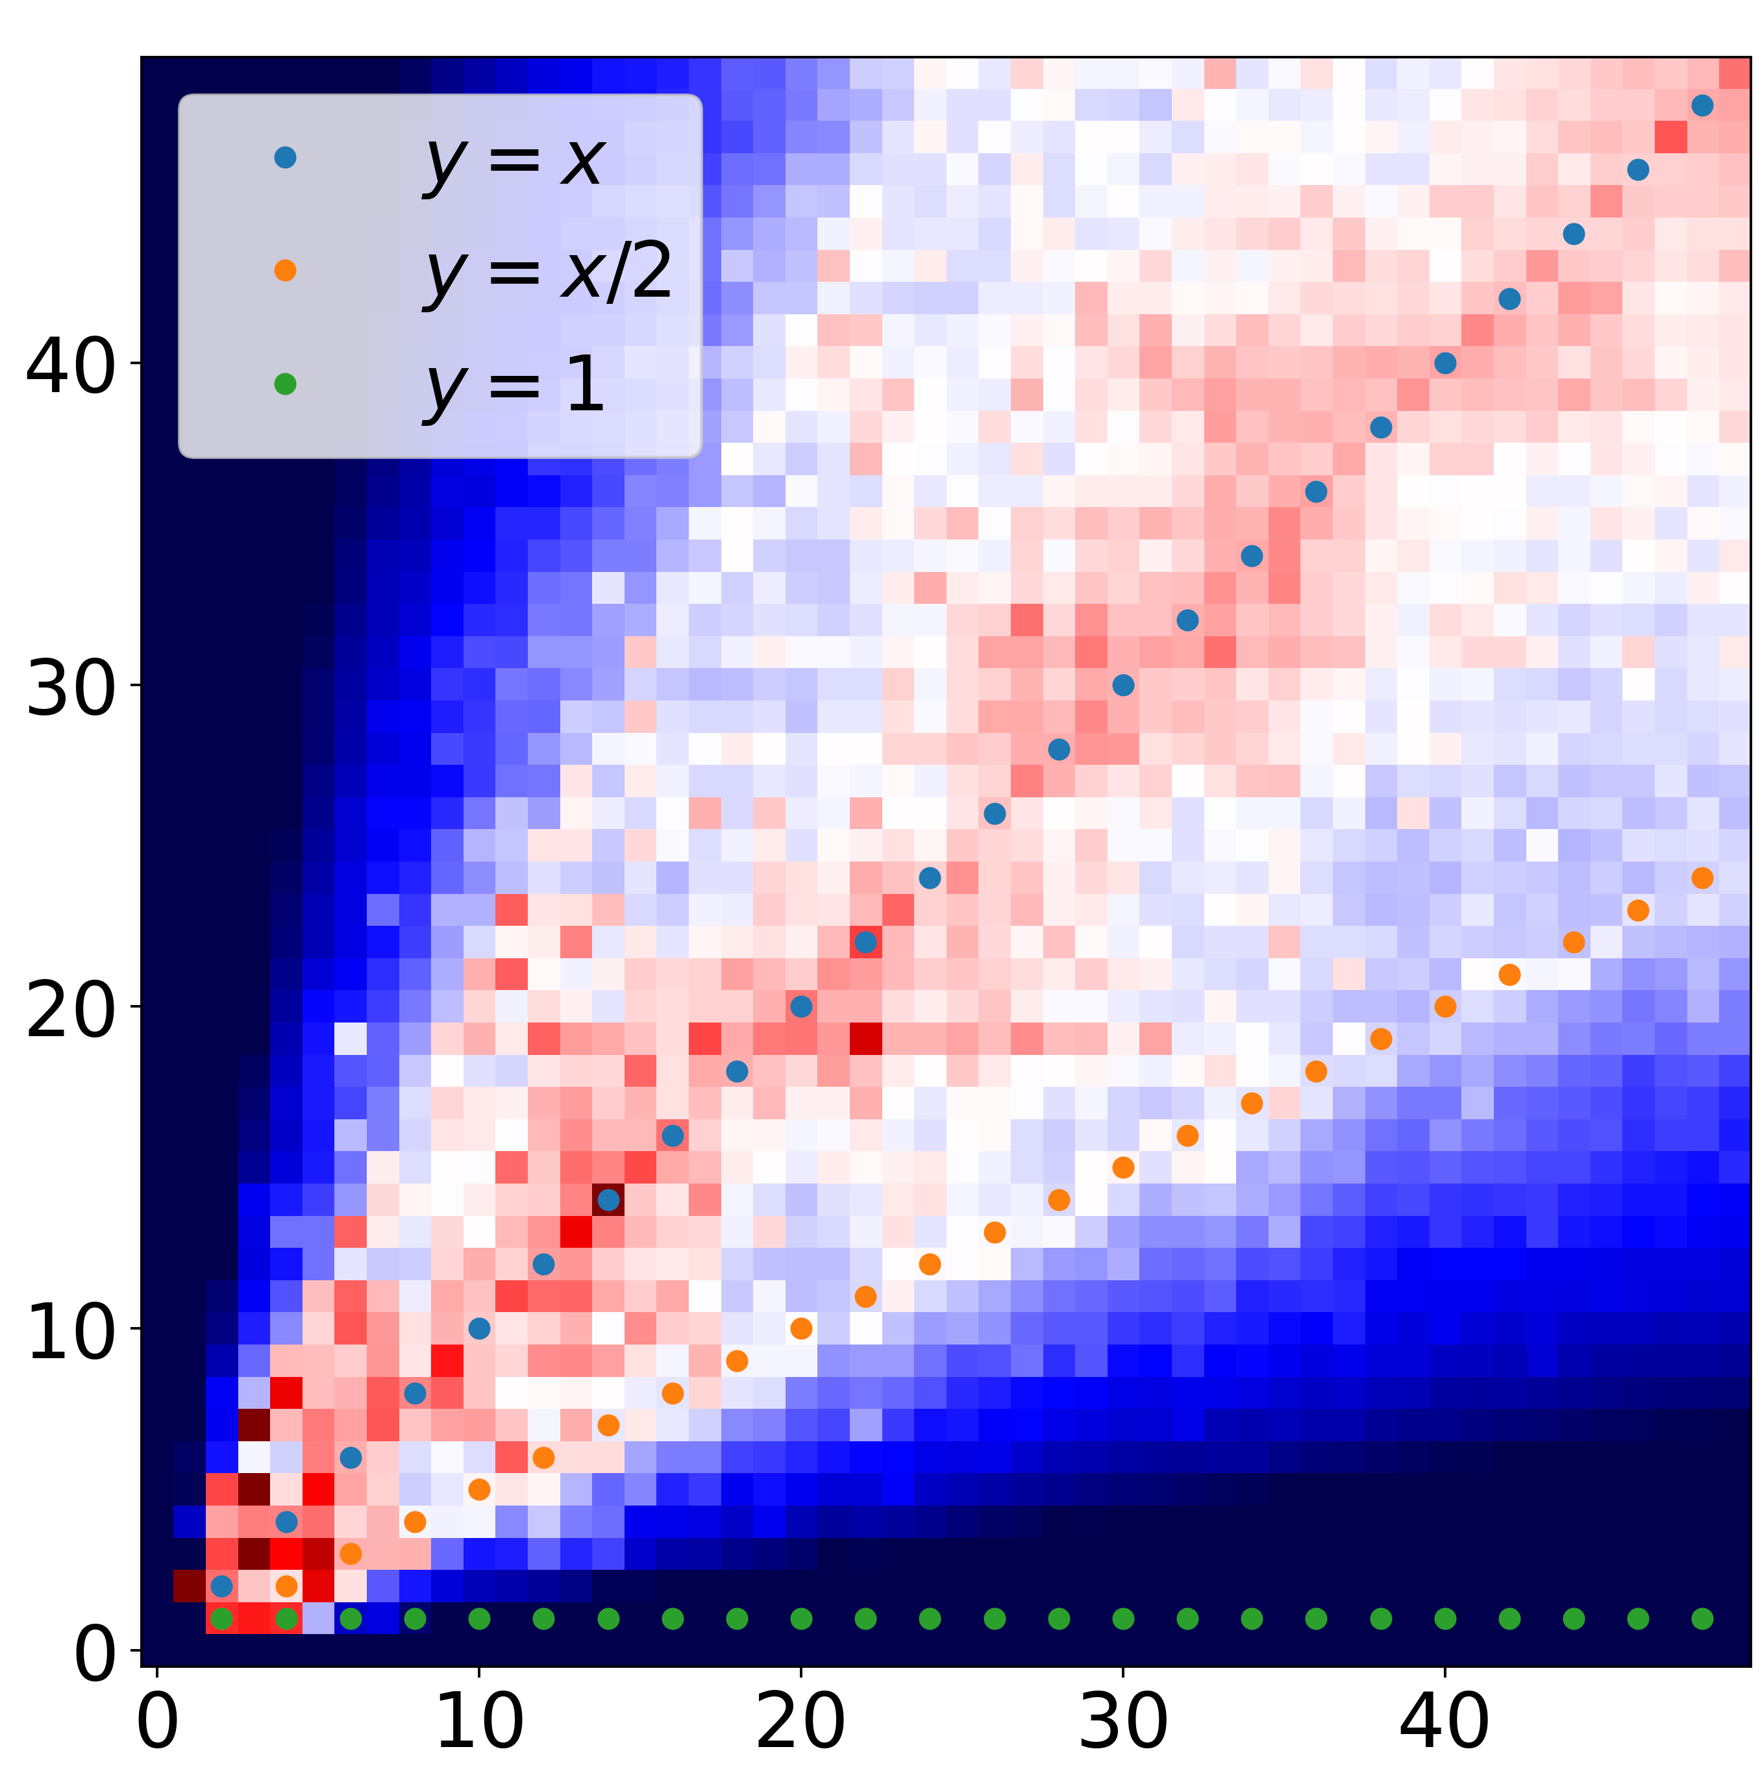
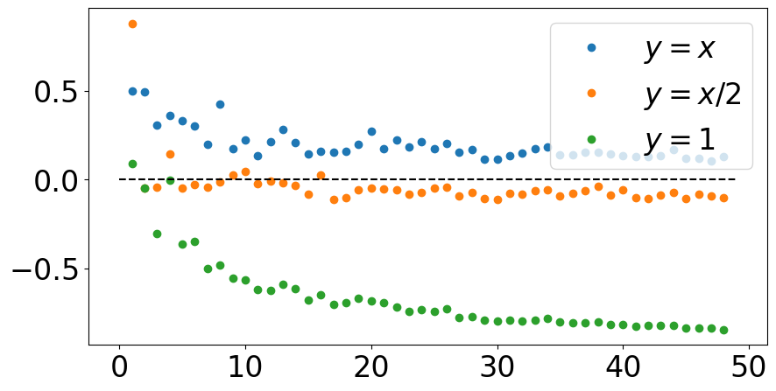
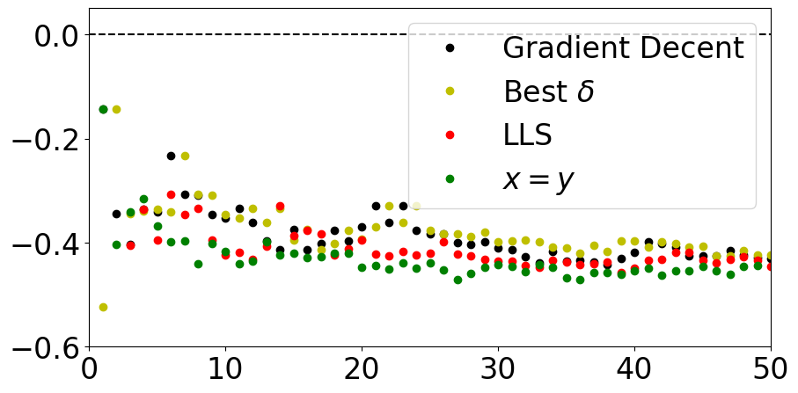
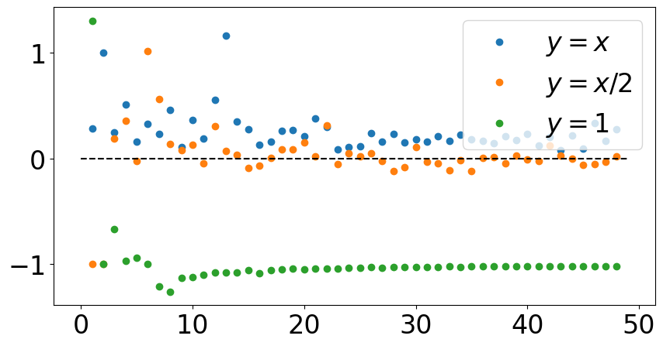
(a)
The CMF for $ζ\left(3\right)$
(b)
The CMF for $ζ\left(3\right)$ shifted by 1/3
(c)
The CMF for $\sqrt[3]{4}$
$$δ$$
$$δ$$
$$δ$$
Location on trajectory
Location on trajectory
Location on trajectory

Slide 51
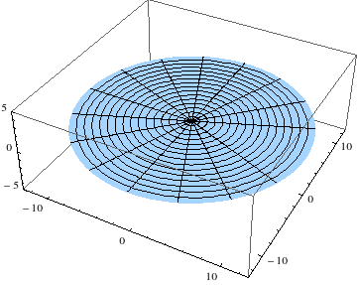
The algorithms that proved promising so far
Identify hidden information in integer sequences
Berlekamp–Massey algorithm
$$\frac{1}{e−2}=\frac{1}{1+\frac{1}{2+\frac{1}{1+\frac{1}{1+\frac{1}{4+\frac{1}{1+\frac{1}{1+\frac{1}{6+\frac{1}{1+\frac{1}{1+\frac{1}{8+\frac{1}{1+\frac{1}{1+…}}}}}}}}}}}}}$$
$$=\frac{1}{4+\frac{1}{41+\frac{1}{1+\frac{1}{4+\frac{1}{1+\frac{1}{1+\frac{1}{1+\frac{1}{3+\frac{1}{1+\frac{1}{1+\frac{1}{1+\frac{1}{1+\frac{1}{4+…}}}}}}}}}}}}}$$
$$\frac{I_{1}(1)}{I_{4}(1)}= ?$$
?
Bessel functions
How drums work
?
?
$$\frac{−138008784938275900393 ⁢I_{1}\left(1\right)+28495979328586484135528 ⁢I_{4}(1)}{310293241489834163497 ⁢I_{1}\left(1\right)−64069180807939297535169 I_{4}(1)}=$$
[4,41,1,4,1,1,1,3,1,1,1,1,4,1,47,4,1,1,4,1,51,4,1,1,2,1,3,2,1,1,4,57,1,4,2,4,1,61,4,1,1,1,3,5,1,1,1,4,67,1,4,2,1,1,1,1,71,2,2,2,1,1,3,1,1,1,2,2,2,77,1,1,1,1,2,1,1,1,1,81,2,2,2,1,24,3,2,2,87,1,1,1,1,3,2300,3,1,3,5,1,3,2450,4,2550,4,6,4,4,2700,4,2,2,111,1,1,1,1,3,1,24,4,1,1,1,1,117,2,2,4,2,2,121,1,1,1,1,4,2,1,3,2,4,1,1,1,1,127,2,2,4,1,4,131,1,4,5,6,4,5,4,1,137,4,1,4,1,
4,141,1,4,5,1,1,3,1,1,1,5,4,1,147,4,1,5,4,1,151,4,1,5,2,1,3,2,5,1,4,157,1,4,6,4,1,161,4,1,5,1,3,5,1,5,1,4,167,1,4,6,1,1,1,1,171,2,2,6,1,1,3,1,1,1,6,2,2,177,1,1,1,1,6,1,1,1,1,181,2,2,6,1,24,7,2,2,187,1,1,1,1,7,4800,7,1,3,5,1,7,4950,8,5050,8,6,4,8,5200,8,2,2,211,1,1,1,1,7,1,24,8,1,1,1,1,217,2,2,8,2,2,221,1,1,1,1,8,2,1,3,2,8,1,1,1,1,227,2,2,8,1,4,231,1,4,9,6,4,9,4,1,237,4,1,8,1,
4,241,1,4,9,1,1,3,1,1,1,9,4,1,247,4,1,9,4,1,251,4,1,9,2,1,3,2,9,1,4,257,1,4,10,4,1,261,4,1,9,1,3,5,1,9,1,4,267,1,4,10,1,1,1,1,271,2,2,10,1,1,3,1,1,1,10,2,2,277,1,1,1,1,10,1,1,1,1,281,2,2,10,1,24,11,2,2,287,1,1,1,1,11,7300,11,1,3,5,1,11,7450,12,7550,12,6,4,12,7700,12,2,2,311,1,1,1,1,11,1,24,12,1,1,1,1,317,2,2,12,2,2,321,1,1,1,1,12,2,1,3,2,12,1,1,1,1,327,2,2,12,1,4,331,1,4,13,6,4,13,4,1,337,4,1,12,1,
4,341,1,4,13,1,1,3,1,1,1,13,4,1,347,4,1,13,4,1,351,4,1,13,2,1,3,2,13,1,4,357,1,4,14,4,1,361,4,1,13,1,3,5,1,13,1,4,367,1,4,14,1,1,1,1,371,2,2,14,1,1,3,1,1,1,14,2,2,377,1,1,1,1,14,1,1,1,1,381,2,2,14,1,24,15,2,2,387,1,1,1,1,15,9800,15,1,3,5,1,15,9950,16,10050,16,6,4,16,10200,16,2,2,411,1,1,1,1,15,1,24,16,1,1,1,1,417,2,2,16,2,2,421,1,1,1,1,16,2,1,3,2,16,1,1,1,1,427,2,2,16,1,4,431,1,4,17,6,4,17,4,1,437,4,1,16,1,
4,441,1,4,17,1,1,3,1,1,1,17,4,1,447,4,1,17,4,1,451,4,1,17,2,1,3,2,17,1,4,457,1,4,18,4,1,461,4,1,17,1,3,5,1,17,1,4,467,1,4,18,1,1,1,1,471,2,2,18,1,1,3,1,1,1,18,2,2,477,1,1,1,1,18,1,1,1,1,481,2,2,18,1,24,19,2,2,487,1,1,1,1,
…
Razon et al., International Conference on Machine Learning (ICML), PMLR, 28809-28842 (2023)

