Slide 1
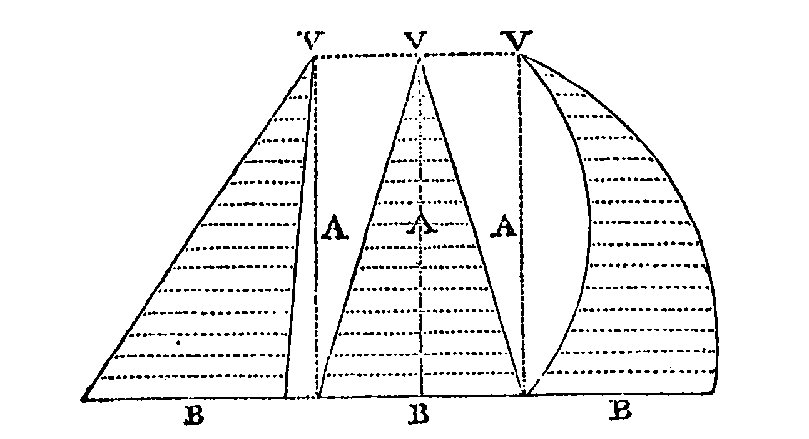
The Experimental Geometer: How John Wallis Saved Mathematics for the Royal Society
Amir Alexander
Rutgers Experimental Mathematics Seminar
October 24, 2024

Slide 2
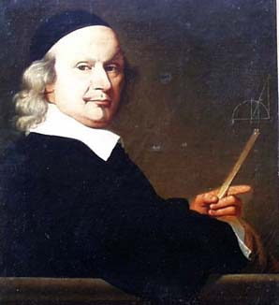
John Wallis, Ca 1650

Slide 3
Gresham College Meeting place of the “invisible college” and early Royal Society

Slide 4
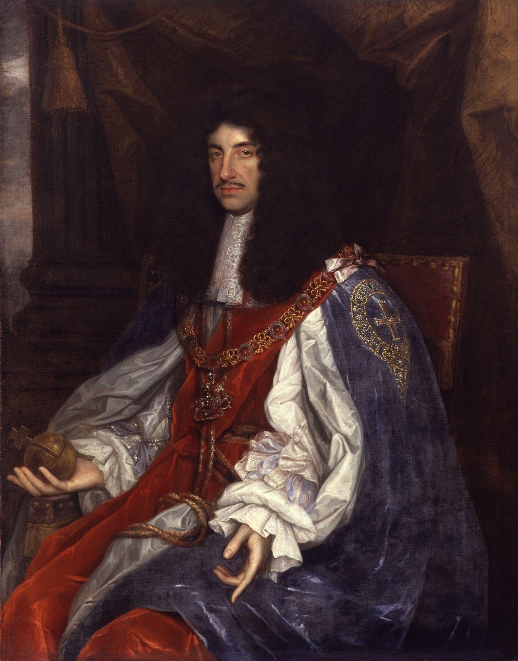
Founding of the Royal Society, 1662

Slide 5
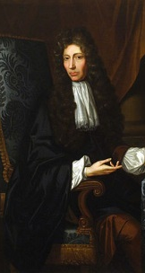
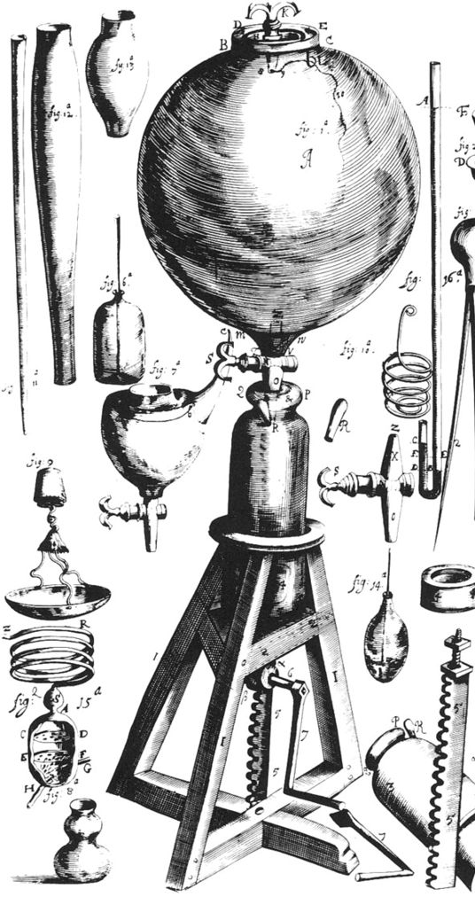
Robert Boyle and his Air Pump

Slide 6
Meeting of the Royal Society

Slide 7
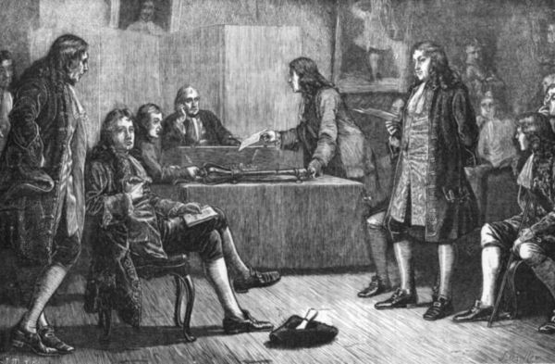
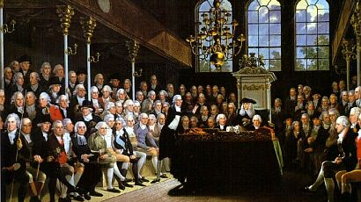
The Royal Society vs. The House of Commons, 18th Century

Slide 8
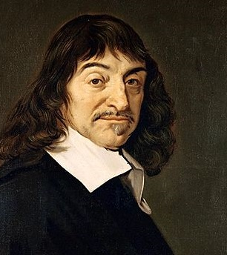
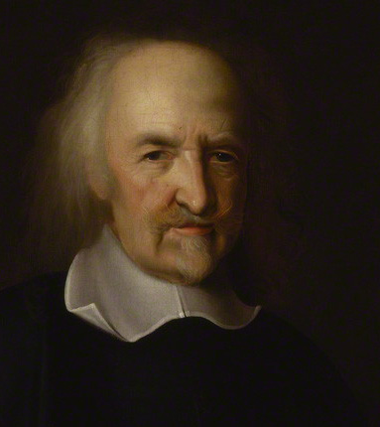
Rational Dogmatists
Descartes and Hobbes

Slide 9
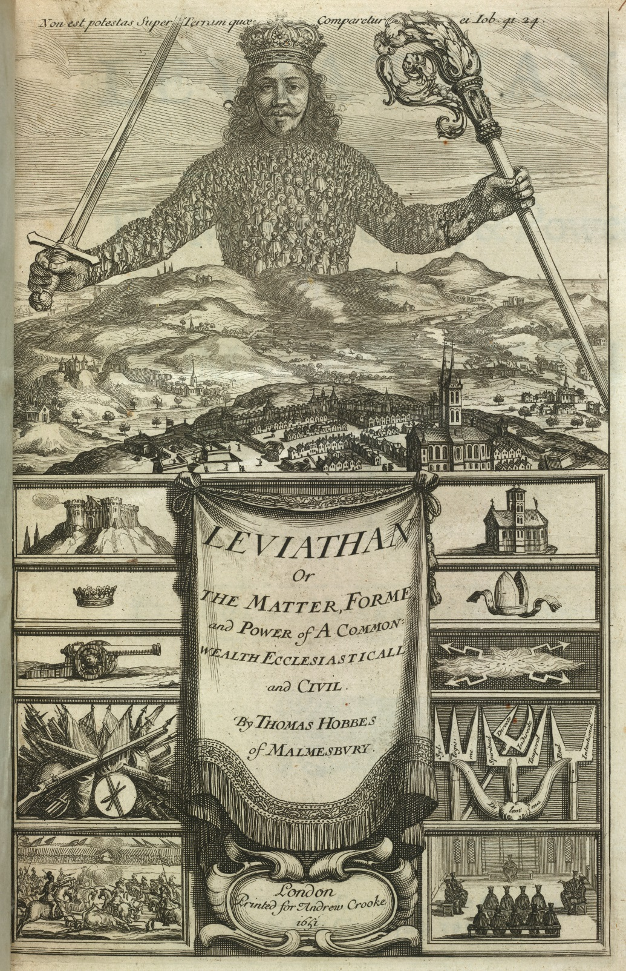
Leviathan

Slide 10
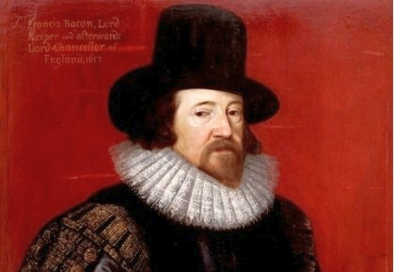
Francis Bacon and the experimental way

Slide 11
John Wallis, Ca 1650

Slide 12
Wallis’ New Mathematics
Treats geometrical bodies as physical objects in the world, not ideal forms to be constructed;
Proceeds not through deductive proof but through trial and error;
Its results would are extremely probable, but not irrefutably certain;
Results would be validated not through “pure reason” but by consensus;
Results judged not by their logical perfection, but by their effectiveness in producing new results.

Slide 13
Material Mathematics
Wallis calculates the area of a triangle as an arithmetic progression:
The sum of all the lines is $\frac{∞}{2}×B$
The thickness of each line is $\frac{1}{∞}×A$
The area of the triangle is therefore
$$\frac{1}{∞}A×\frac{∞}{2}B=\frac{AB}{2}$$
De Sectionibus Conicis (1655)

Slide 14
Wallis’s Method
Mathematical entities exist, not in the imagination but in reality.
Mathesis Universalis, 1657

Slide 15
Wallis’s Method
The simplest method of investigation, in this and various problems that follow, is to exhibit the thing to a certain extent, and to observe the ratios produced and compare them to each other; so that at length a general proposition may become known by induction.
Arithmetica Infinitorum, 1656

Slide 16
Francis Bacon and The New Organon, 1620

Slide 19
Francis Bacon and the experimental way

Slide 20
John Wallis and the experimental way

Slide 21
Wallis’s Calculation of the ratio between a square and an enclosed circle
$$\frac{4}{π}=\frac{3×3×5×5×7×7×9×9×11×11×…}{2×4×4×6×6×8×8×10×10×12×…}$$

Slide 22
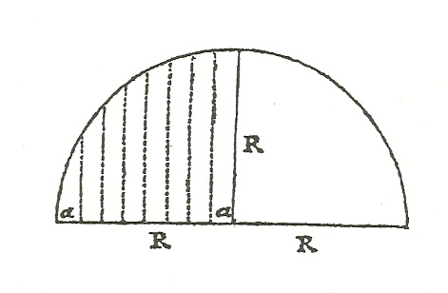
Experimental Mathematics
The ratio between the circle quadrant and the square is
$\frac{{r_{0}+r}_{1}+r_{2}+r_{3}+…+r_{n}}{R+R+R+R+…+R}$
Or $$\frac{\sqrt{R^{2}−0^{2}}+\sqrt{R^{2}−1^{2}}+\sqrt{R^{2}−2^{2}}+\sqrt{R^{2}−3^{2}}+…+\sqrt{R^{2}−R^{2}}}{R + R + R + R +…+ R}$$
Arithmetica Infinitorum (1655)

Slide 23
Wallis’s Method of Induction
$\frac{0+1}{1+1}=\frac{1}{2}$
$\frac{0+1+2=3}{2+2+2=6}=\frac{1}{2}$
$\frac{0+1+2+3=6}{3+3+3+3=12}=\frac{1}{2}$
$\frac{0+1+2+3+4=10}{4+4+4+4+4=20}=\frac{1}{2}$
Therefore:
$\lim_{n→∞}{\frac{0+1+2+3+…+n}{n+n+n+n+…+n}=\frac{1}{2}}$
$\frac{0+1=1}{1+1=2}=\frac{1}{2}=\frac{1}{3}+\frac{1}{6}$:
$\frac{0+1+4=5}{4+4+4=12}=\frac{5}{12}=\frac{1}{3}+\frac{1}{12}$
$\frac{0+1+4+9=14}{9+9+9+9=36}=\frac{14}{36}=\frac{1}{3}+\frac{1}{18}$
$\frac{0+1+4+9+16=30}{16+16+16+16+16=80}=\frac{30}{80}=\frac{3}{8}=\frac{1}{3}+\frac{1}{24}$
Therefore:
$\lim_{n→∞}\frac{0^{2}+1^{2}+2^{2}+3^{2}+…+n^{2}}{n^{2}+n^{2}+n^{2}+n^{2}+…+n^{2}}=\frac{1}{3}$
$\frac{0+1=1}{1+1=2}=\frac{2}{4}=\frac{1}{4}+\frac{1}{4}$
$\frac{0+1+8=9}{8+8+8=24}=\frac{3}{8}=\frac{1}{4}+\frac{1}{8}$
$\frac{0+1+8+27=36}{27+27+27+27=108}=\frac{4}{12}=\frac{1}{4}+\frac{1}{12}$
$\frac{0+1+8+27+64=100}{64+64+64+64+64=320}=\frac{5}{16}=\frac{1}{4}+\frac{1}{16}$
Therefore:
$\lim_{n→∞}\frac{0^{3}+1^{3}+2^{3}+3^{3}+…+n^{3}}{n^{3}+n^{3}+n^{3}+n^{3}+…+n^{3}}=\frac{1}{4}$
Therefore:
$$\lim_{n→∞}\frac{0^{m}+1^{m}+2^{m}+3^{m}+…+n^{m}}{n^{m}+n^{m}+n^{m}+n^{m}+…+n^{m}}=\frac{1}{m+1}$$

Slide 24
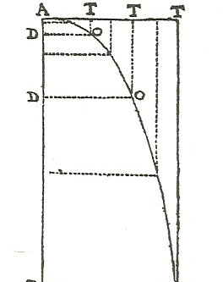
Wallis’s Approach
Half a cubic parabola and its enclosing rectangle. Wallis’ inductive proof demonstrates that the ratio between the area AOT outside the cubic parabola and the area of the enclosing rectangle is $\frac{1}{4}$.
Arithmetica Infinitorum, Prop. 42.

Slide 25
Fermat

Slide 26
Wallis’s Method of Persuasion
[M]ost mathematicians that I have seen, after such induction continued for some steps… are satisfied (from such evidence) to conclude universally and so in like manner for the consequent powers. And such Induction hath been hitherto thought…a conclusive argument.
A Treatise of Algebra, p. 308.

Slide 27
Mathematics for the Royal Society
Investigates external objects, not constructed ones;
Relies on induction, not deduction;
Does not claim to have arrived at an absolute final truth
The final arbiter of the worth of a demonstration was the consensus of men, not logical compulsion.
Overall: A modest, tolerant, and consensus-driven mathematics…
…inspired by the modest, tolerant, and consensus-driven experimental approach

