Slide 1
SI and SIR Models
Brian Jin, Brian Koo, and Praneeth Vedantham

Slide 2
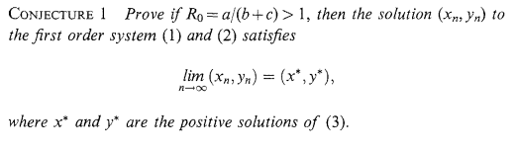

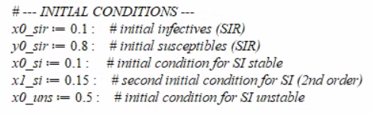

Conjecture 1
For the SIR model, if a/(b+c) > 1, then:
Equilibrium exists
Orbit converges to equilibrium
Stable

Slide 3
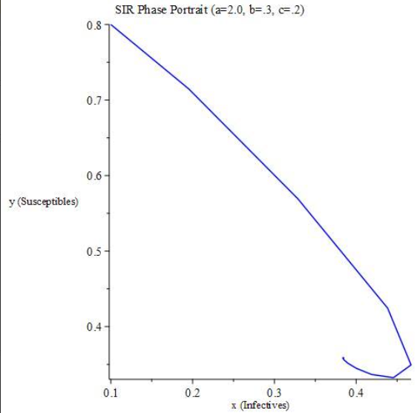
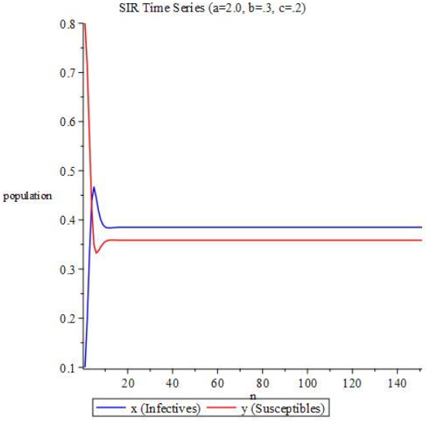
Conjecture 1 Graphs
R = a/(b + c) = 4
Endemic equilibrium is reached

Slide 4
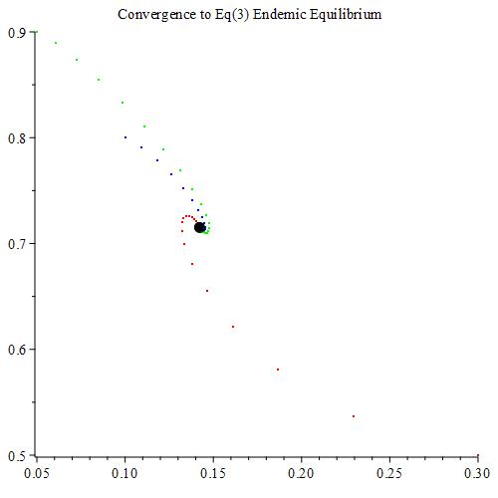
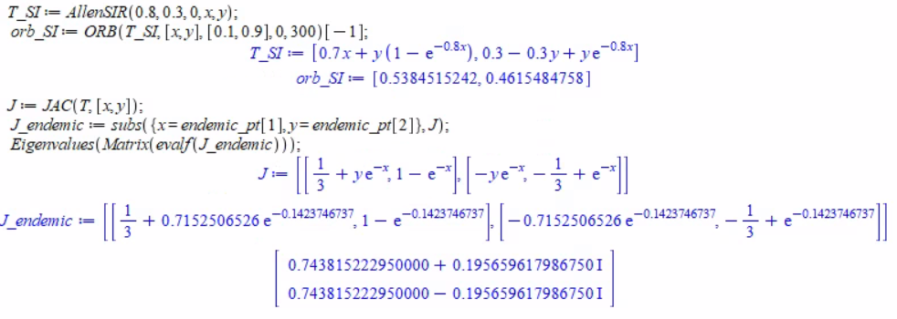
Conjecture 1 Graphs
a = 0.1, b = c = 0.3333
Endemic equilibrium is reached for initial conditions:
[0.1, 0.8]
[0.3, 0.5]
[0.05, 0.9]

Slide 5
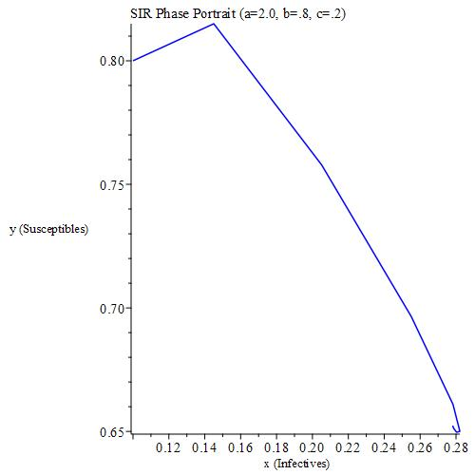
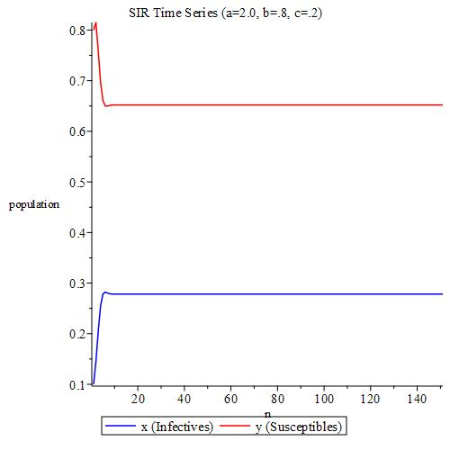
Conjecture 1 Graphs
R = a/(b + c) = 2
Endemic equilibrium is reached

Slide 6
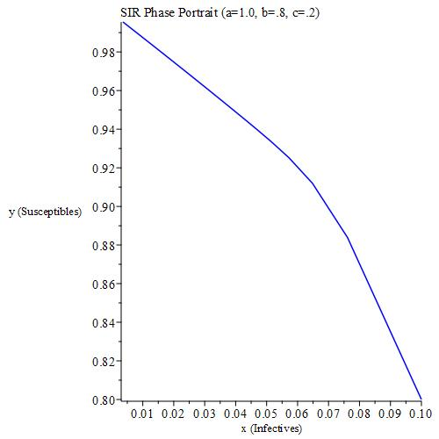
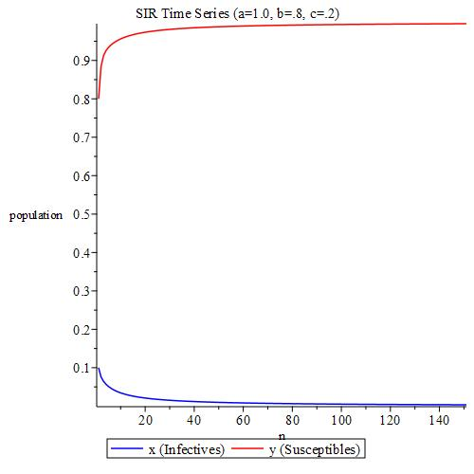
Conjecture 1 Graphs
R = a/(b + c) = 1
Virus dies out of population

Slide 7
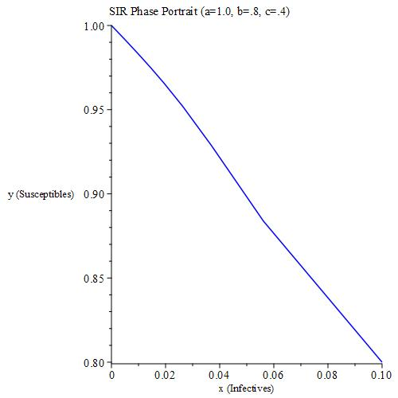
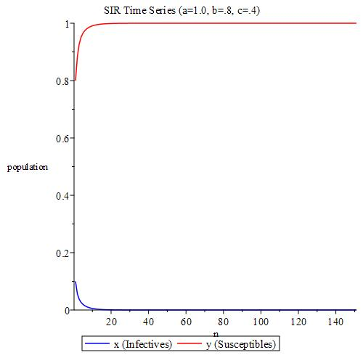
Conjecture 1 Graphs
R = a/(b + c) = 0.833
Virus dies out of population

Slide 8
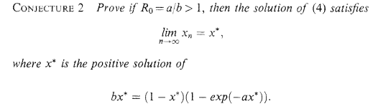
Conjecture 2
For SI model, if a/b > 1, then:
Equilibrium exists
Absolute value of eigenvalues are less than 1
Orbits converge
If a/b < 1, then:
Equilibrium becomes unstable
Orbits oscillate/diverge

Slide 9
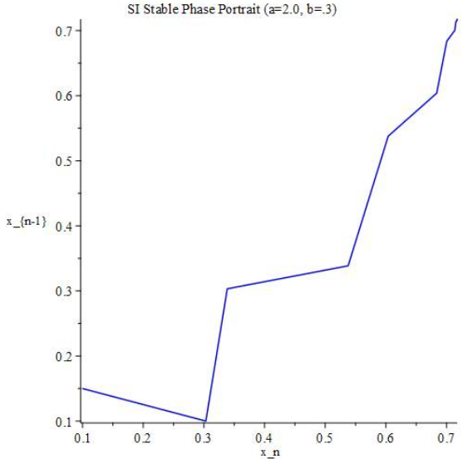
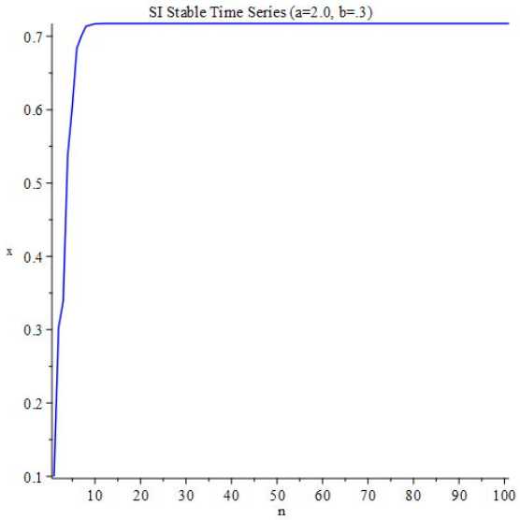
Conjecture 2 Graphs (Stable)
R = a/b = 6.667
Endemic equilibrium is reached

Slide 10
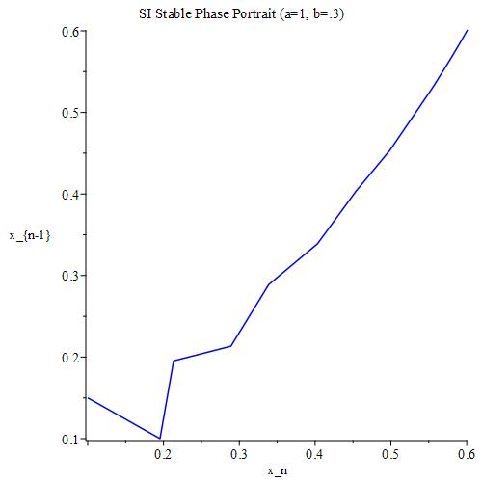
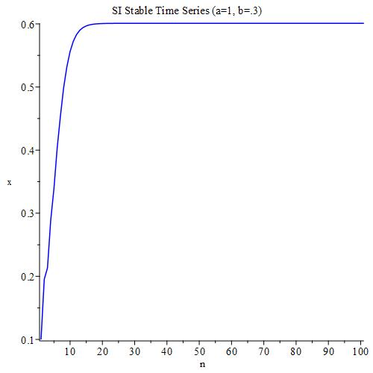
Conjecture 2 Graphs (Stable)
R = a/b = 3.3333
Endemic equilibrium is reached

Slide 11
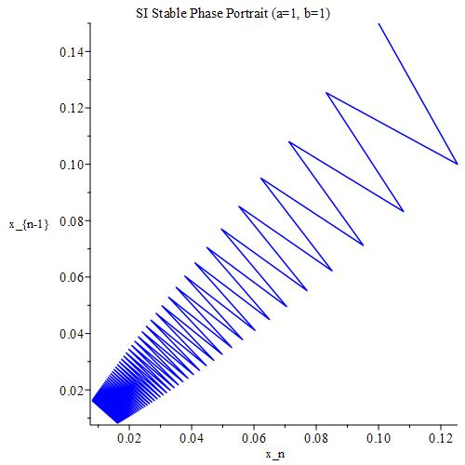
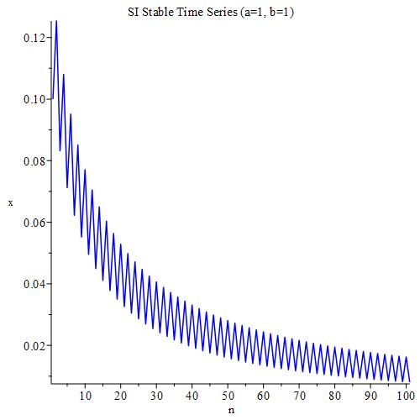
Conjecture 2 Graphs (Stable-ish)
R = a/b = 1
Oscillations occur

Slide 12
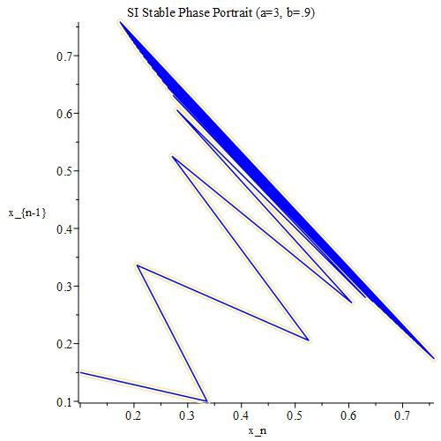
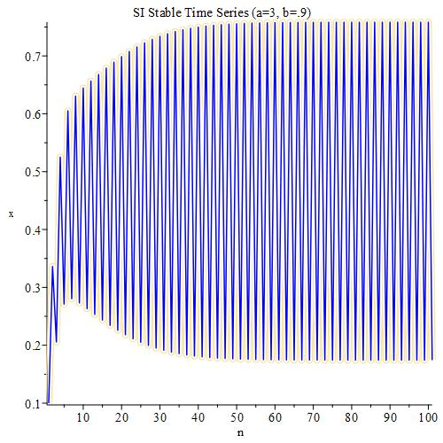
Conjecture 2 Graphs (Unstable)
R = a/b = 3.333
Oscillations occur

Slide 13
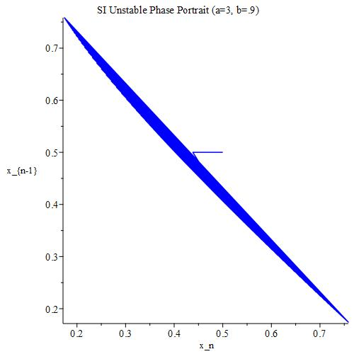
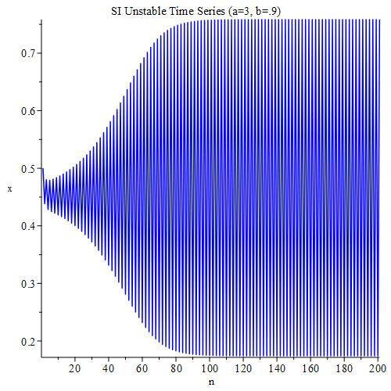
Conjecture 2 Graphs (Unstable)
R = a/b = 3.333
Oscillations occur

Slide 14
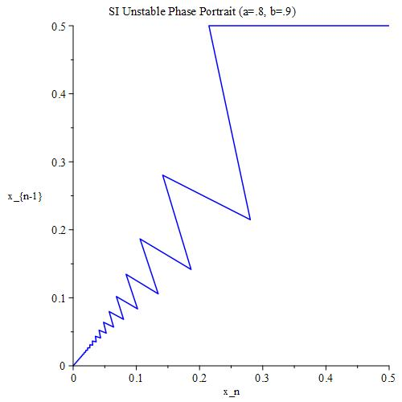
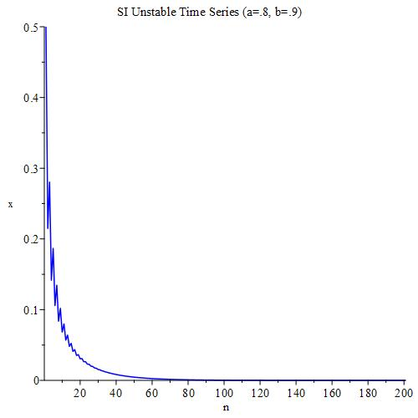
Conjecture 2 Graphs (Unstable)
R = a/b = 0.8889
Virus dies out of population

Slide 15
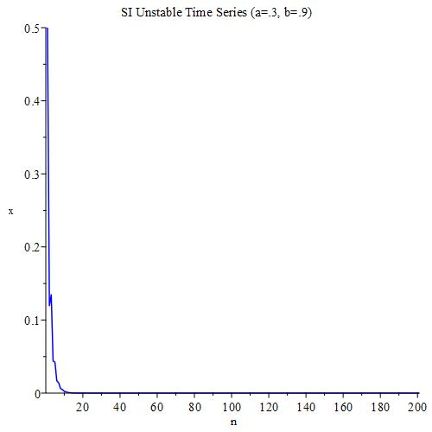
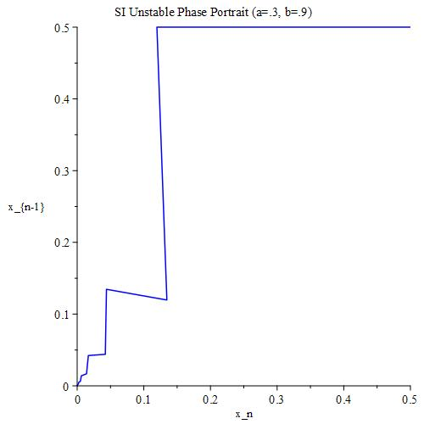
Conjecture 2 Graphs (Unstable)
R = a/b = 0.3333
Virus dies out of population

Slide 16
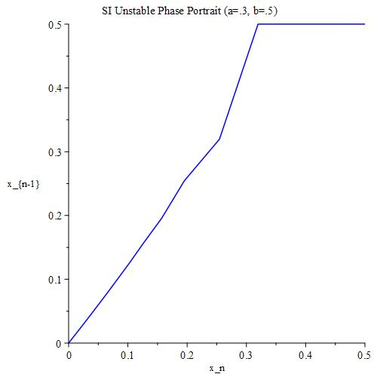
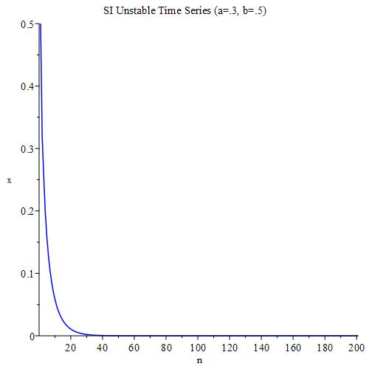
Conjecture 2 Graphs (Unstable)
R = a/b = 0.6
Virus dies out of population

