Slide 1
Introduction to Lie algebras

Slide 2








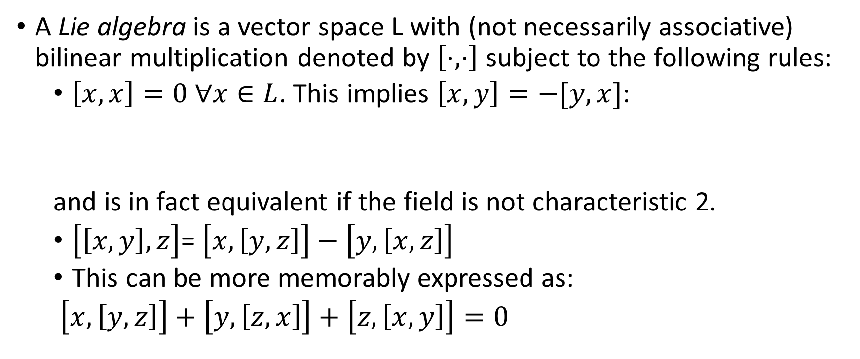

Definitions
A Lie algebra is a vector space L with (not necessarily associative) bilinear multiplication denoted by $\left[⋅,⋅\right]$ subject to the following rules:
  $\left[x,x\right]=0 ∀x∈L$. This implies $\left[x,y\right]=−[y,x]$:
  and is in fact equivalent if the field is not characteristic 2.
  $\left[\left[x,y\right],z\right]$= $\left[x,\left[y,z\right]\right]−\left[y,\left[x,z\right]\right]$
  This can be more memorably expressed as:
  $\left[x,\left[y,z\right]\right]+\left[y,\left[z,x\right]\right]+\left[z,\left[x,y\right]\right]=0$

Slide 3
Examples
If V is any vector space, End(V) (=gl(n,F) if V is n-dimensional) can be made into a Lie algebra via [A,B]=AB-BA. Check it:
Vector cross-product is another example: [i,j]=k, [j,k]=i, [k,i]=j.

Slide 4













































Slide 5











Homomorphisms, ideals
A subspace $I$ is an ideal of $L$in case $\left[I,L\right]⊂I$.
Ex: $I=Z\left(L\right)=\{x∈L:\left[x,L\right]=0\}$
$φ:L_{1}→L_{2}, φ\left(\left[x,y\right]\right)=\left[φ\left(x\right),φ\left(y\right)\right]$
Most important homomorphism: the adjoint

Slide 6





































Slide 7


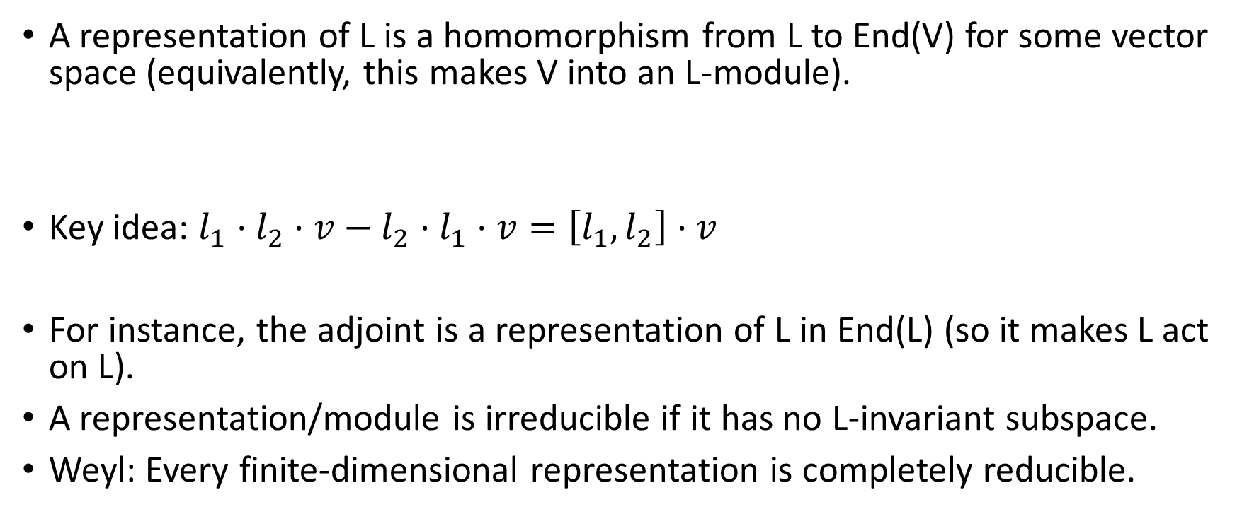
Representations
A representation of L is a homomorphism from L to End(V) for some vector space (equivalently, this makes V into an L-module).
Key idea: $l_{1}⋅l_{2}⋅v−l_{2}⋅l_{1}⋅v=\left[l_{1},l_{2}\right]⋅v$
For instance, the adjoint is a representation of L in End(L) (so it makes L act on L).
A representation/module is irreducible if it has no L-invariant subspace.
Weyl: Every finite-dimensional representation is completely reducible.

Slide 8
















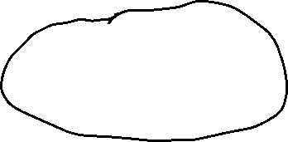
Simple Lie algebras
A Lie algebra is simple if it has no proper ideals. We exclude 0 and 1-dimensional Lie algebras.
Ex: Vector cross product
Note End(V)=gl(n) (if V is n-dimensional) is not simple. Why?

Slide 9










sl(n)
Note the space of trace-0 $n×n$matrices form a Lie subalgebra of gl(n): tr(AB)=tr(BA) so tr(AB-BA)=0
This space is called sl(n); it turns out for n>1, this Lie algebra is simple.

Slide 10















sl(2)
Typically the following letters are used for the basis:
And note the following relations:
$$\left[h,e\right]=2e, \left[h,f\right]=−2f, \left[e,f\right]=h$$

Slide 11
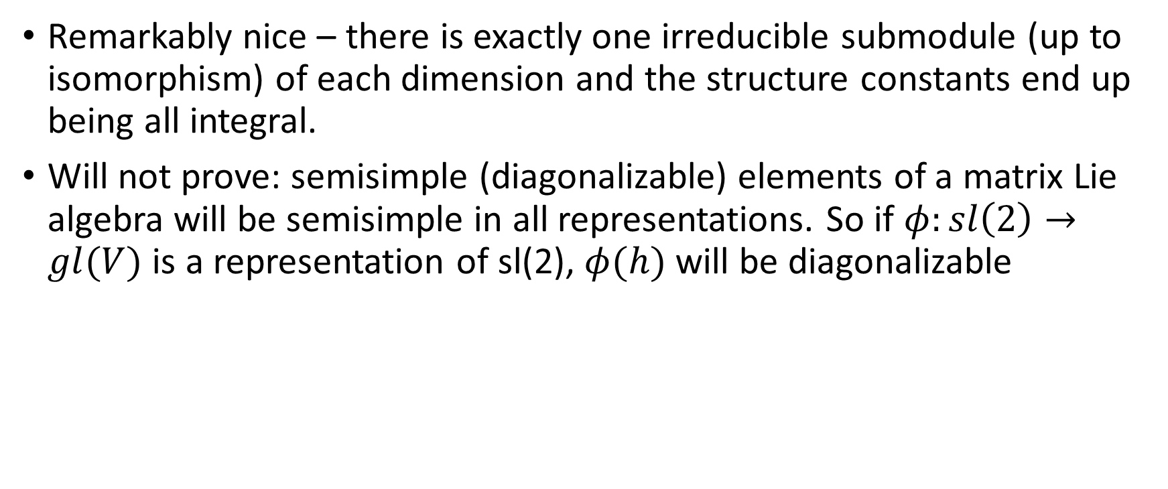
Module theory for sl(2)
Remarkably nice – there is exactly one irreducible submodule (up to isomorphism) of each dimension and the structure constants end up being all integral.
Will not prove: semisimple (diagonalizable) elements of a matrix Lie algebra will be semisimple in all representations. So if $φ:sl\left(2\right)→gl(V)$ is a representation of sl(2), $φ(h)$ will be diagonalizable

Slide 12















Let V be a finite-dimensional irreducible module of sl(2). Then let $V=⨁V_{λ}$ be the decomposition of V into eigenspaces of the action of h.
Note $e⋅V_{λ}⊂V_{λ+2}$. Why?
Likewise, $f⋅V_{λ}⊂V_{λ−2}$

Slide 13




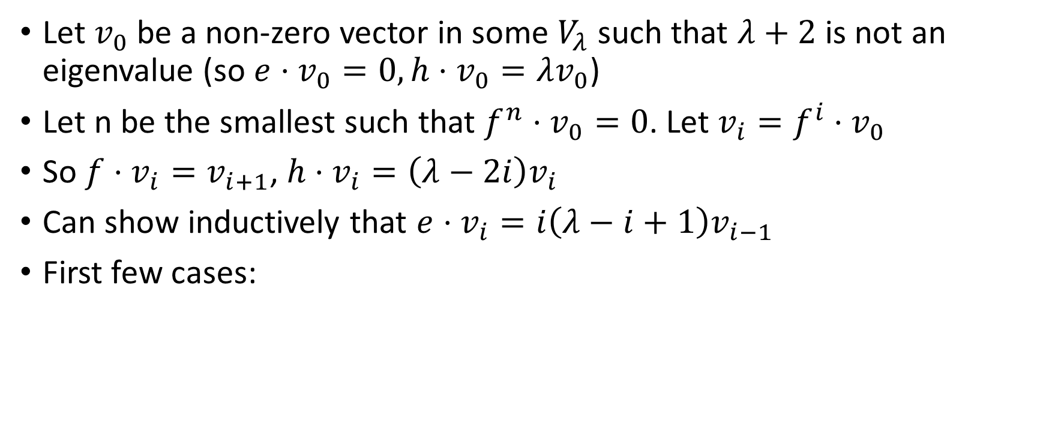

Module theory for sl(2)
Let $v_{0}$ be a non-zero vector in some $V_{λ}$ such that $λ+2$is not an eigenvalue (so $e⋅v_{0}=0, h⋅v_{0}=λv_{0}$)
Let n be the smallest such that $f^{n}⋅v_{0}=0$. Let $v_{i}=f^{i}⋅v_{0}$
So $f⋅v_{i}=v_{i+1}$, $h⋅v_{i}=\left(λ−2i\right)v_{i}$
Can show inductively that $e⋅v_{i}=i\left(λ−i+1\right)v_{i−1}$
First few cases:

Slide 14




















Slide 15












Module theory for sl(2)
Note that this means the span of $v_{0},…v_{n−1}$ form a submodule, thus they form a basis for module (by assumption of irreducibility) of dimension n.
Finally, we can show that we must have $λ=n−1:$

Slide 16











Slide 17
Summary of results for irred. sl(2)-modules
For each positive dimension n, there is exactly one sl(2) module of that dimension (up to isomorphism).
h will act diagonally on this module and have eigenvalues n-1, n-3,… -(n-1); each eigenspace will be 1-dimensional.

Slide 18
Application to other simple Lie algebras
We will see soon that all simple Lie algebras have copies of sl(2) as subalgebras
So these Lie algebras can be viewed as sl(2)-modules via the adjoint representation of the sl(2) subalgebra.

Slide 19

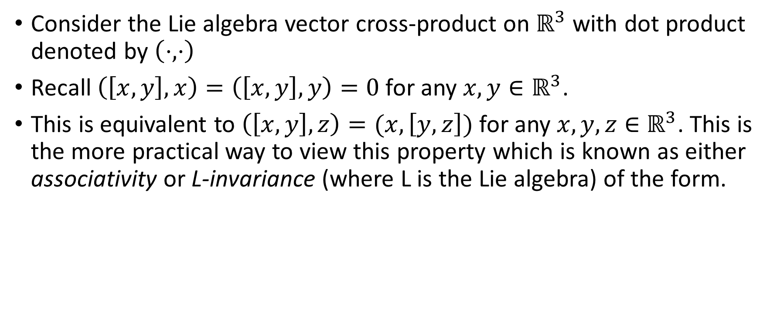



An associative, symmetric bilinear form
Consider the Lie algebra vector cross-product on $ℝ^{3}$ with dot product denoted by $\left(⋅,⋅\right)$
Recall $\left(\left[x,y\right],x\right)=\left(\left[x,y\right],y\right)=0$ for any $x,y∈ℝ^{3}$.
This is equivalent to $\left(\left[x,y\right],z\right)=(x,\left[y,z\right])$ for any $x,y,z∈$ $ℝ^{3}$. This is the more practical way to view this property which is known as either associativity or L-invariance (where L is the Lie algebra) of the form.

Slide 20















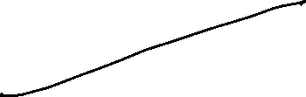




















Slide 21
An associative, symmetric bilinear form
Vector cross product and sl(2,ℝ) are not isomorphic – but their complexifications are!
This isomorphism sends dot product to an associative form on sl(2) (but it will no longer be positive-definite on sl(2, ℝ))

Slide 22






The Killing form
Let L be any Lie algebra. Equip L with a symmetric bilinear form: $\left(x,y\right)=Tr(ad_{x}ad_{y})$
This form is associative:

Slide 23


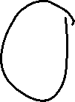








The Killing form
If L is simple, this form will be non-degenerate; in fact it will be the only nondegenerate symmetric associative form up to scalar multiple.
If L (simple) is expressed as a matrix algebra, (x,y)=Tr(xy) will also be nondegenerate and thus be a scalar multiple of the Killing form that is often easier to compute.
Using this form, we see (e,f)=1, (h,h)=2, (h,e)=(h,f)=(e,e)=(f,f)=0.

