Slide 1
The Affine Weyl group and Affine Lie algebras

Slide 2
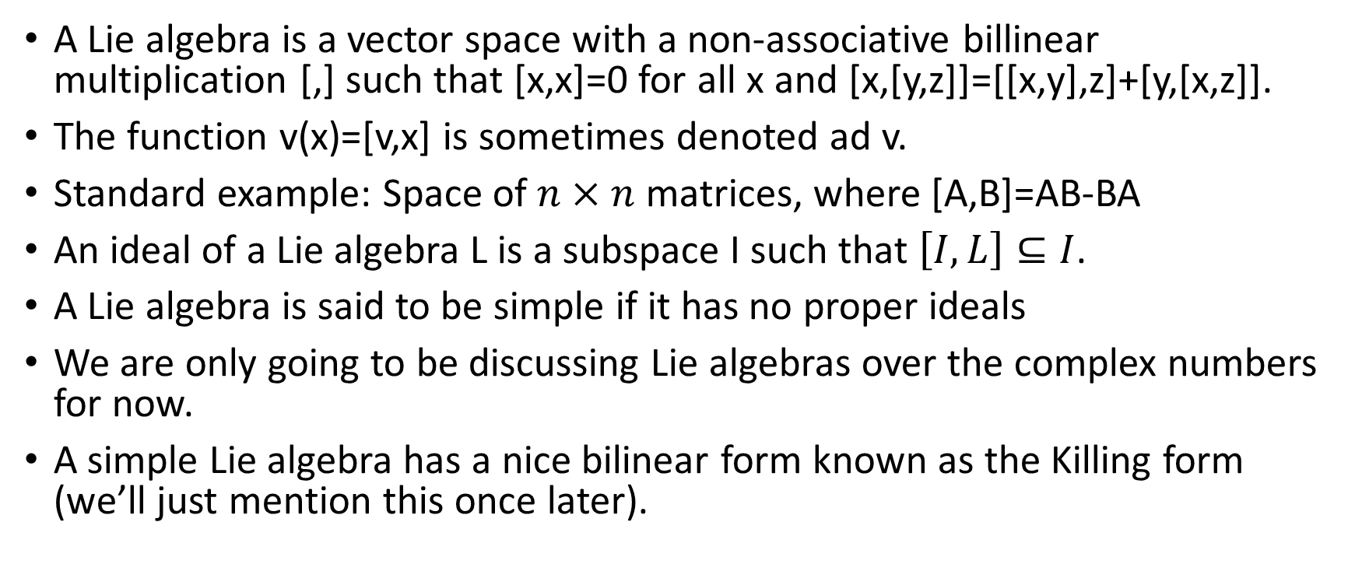
Quick definition dump
A Lie algebra is a vector space with a non-associative billinear multiplication [,] such that [x,x]=0 for all x and [x,[y,z]]=[[x,y],z]+[y,[x,z]].
The function v(x)=[v,x] is sometimes denoted ad v.
Standard example: Space of $n×n$ matrices, where [A,B]=AB-BA
An ideal of a Lie algebra L is a subspace I such that $\left[I,L\right]⊆I$.
A Lie algebra is said to be simple if it has no proper ideals
We are only going to be discussing Lie algebras over the complex numbers for now.
A simple Lie algebra has a nice bilinear form known as the Killing form (we’ll just mention this once later).

Slide 3
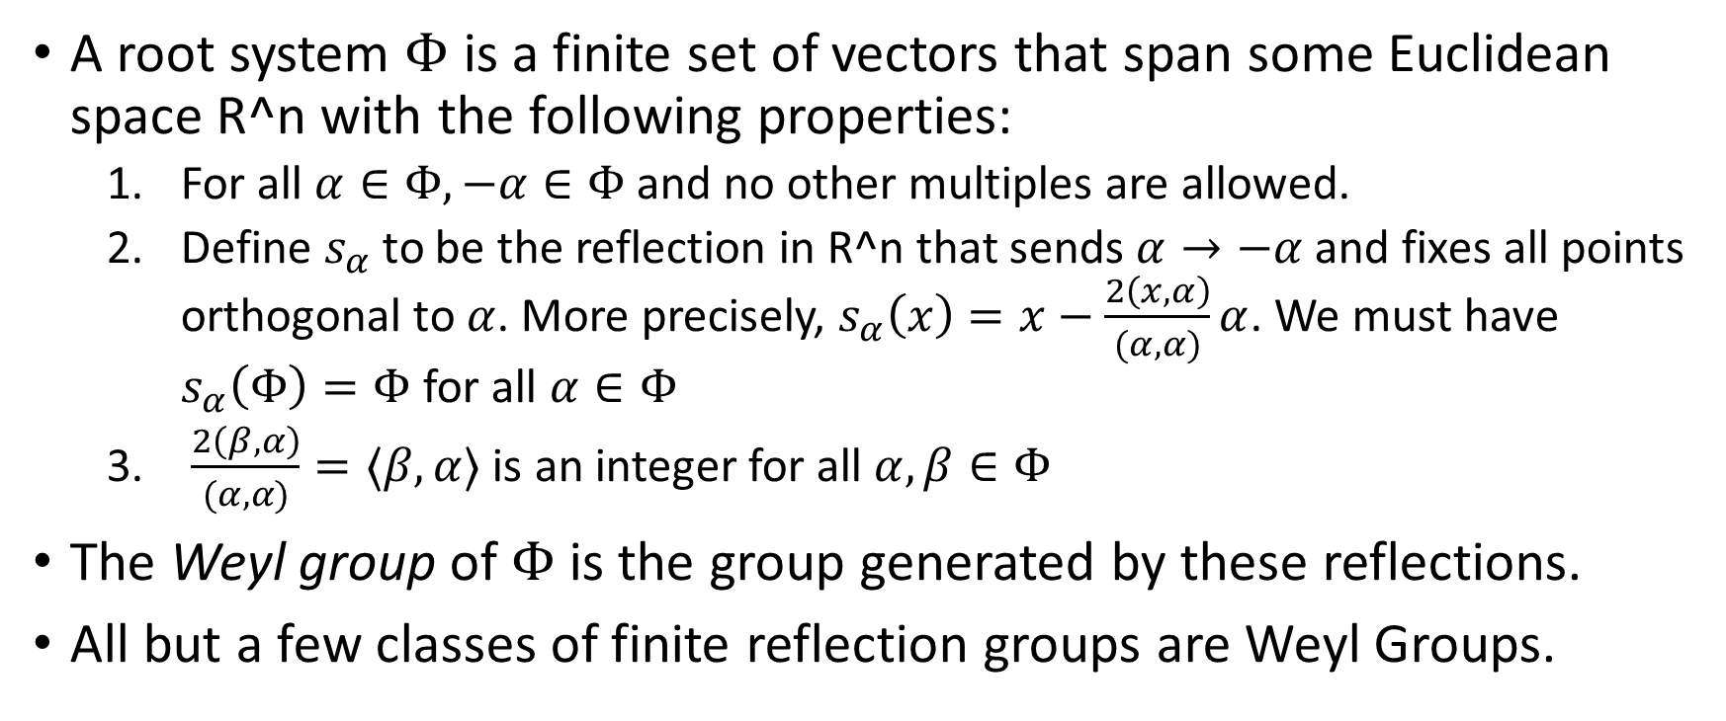
Root System quick review
A root system $Φ$ is a finite set of vectors that span some Euclidean space R^n with the following properties:
  For all $α∈Φ, −α∈Φ$ and no other multiples are allowed.
  Define $s_{α}$ to be the reflection in R^n that sends $α→−α$ and fixes all points orthogonal to $α$. More precisely, $s_{α}\left(x\right)=x−\frac{2\left(x,α\right)}{(α, α)}α$. We must have $s_{α}\left(Φ\right)=Φ$ for all $α∈Φ$
  $\frac{2\left(β,α\right)}{(α, α)}=⟨β,α⟩$ is an integer for all $α, β∈Φ$
The Weyl group of $Φ$ is the group generated by these reflections.
All but a few classes of finite reflection groups are Weyl Groups.

Slide 4
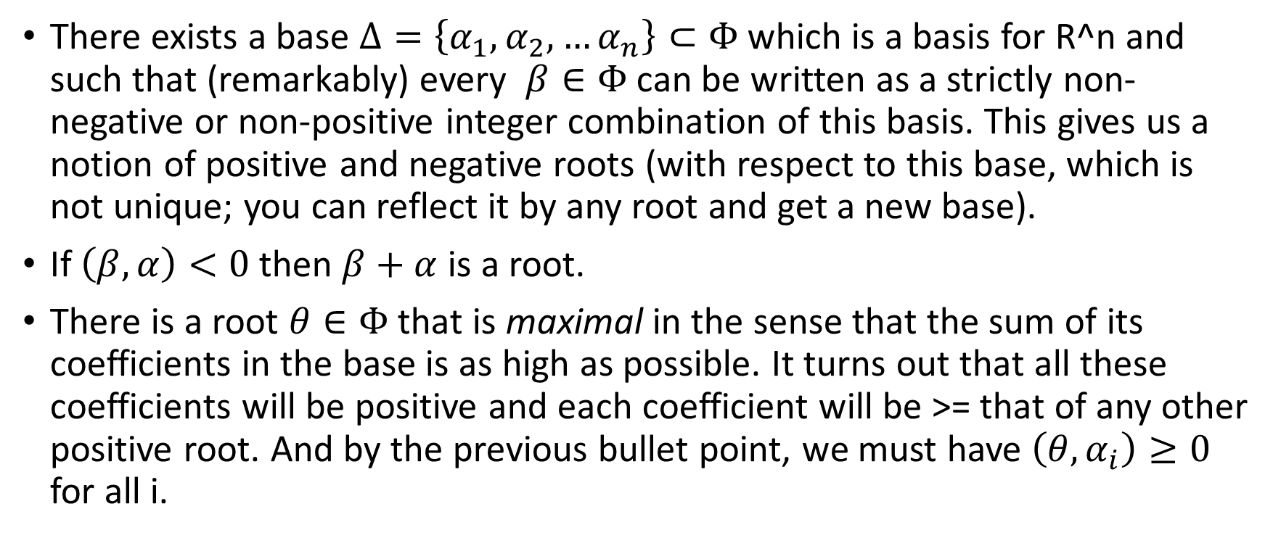
Root System properties
There exists a base $Δ=\left\{α_{1},α_{2},…α_{n}\right\}⊂Φ$ which is a basis for R^n and such that (remarkably) every $β∈Φ$ can be written as a strictly non-negative or non-positive integer combination of this basis. This gives us a notion of positive and negative roots (with respect to this base, which is not unique; you can reflect it by any root and get a new base).
If $\left(β,α\right)<0$ then $β+α$ is a root.
There is a root $θ∈Φ$ that is maximal in the sense that the sum of its coefficients in the base is as high as possible. It turns out that all these coefficients will be positive and each coefficient will be >= that of any other positive root. And by the previous bullet point, we must have $\left(θ,α_{i}\right)≥0$ for all i.

Slide 5
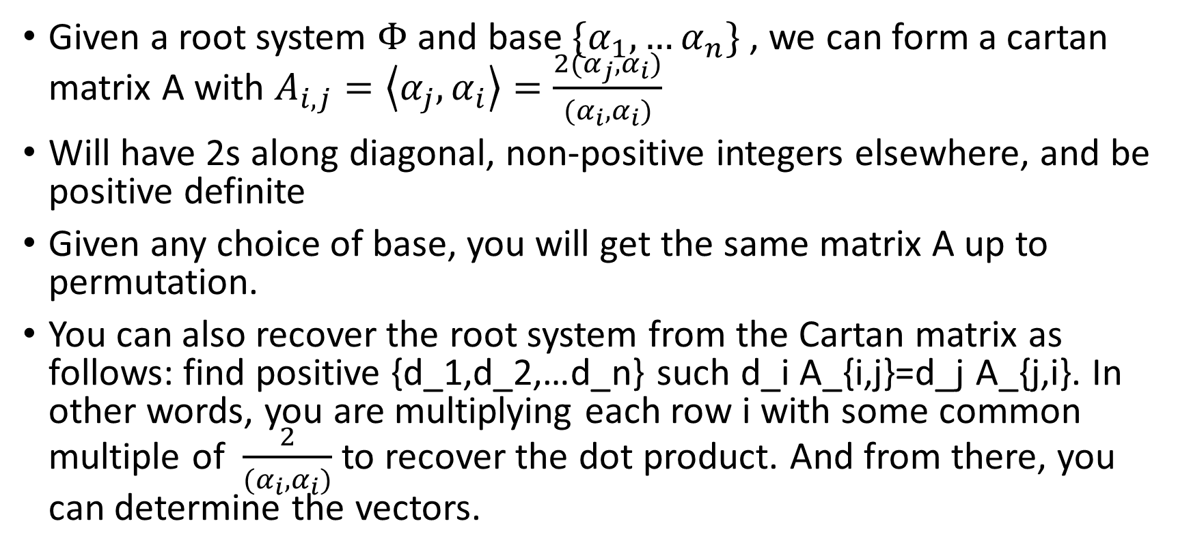
Cartan Matrices
Given a root system $Φ$and base $\{α_{1},…α_{n}\}$, we can form a cartan matrix A with $A_{i,j}=\left\langle α_{j},α_{i}\right\rangle =\frac{{2(α}_{j}, α_{i})}{(α_{i}, α_{i})}$
Will have 2s along diagonal, non-positive integers elsewhere, and be positive definite
Given any choice of base, you will get the same matrix A up to permutation.
You can also recover the root system from the Cartan matrix as follows: find positive {d_1,d_2,…d_n} such d_i A_{i,j}=d_j A_{j,i}. In other words, you are multiplying each row i with some common multiple of $\frac{2}{(α_{i}, α_{i})}$ to recover the dot product. And from there, you can determine the vectors.

Slide 6
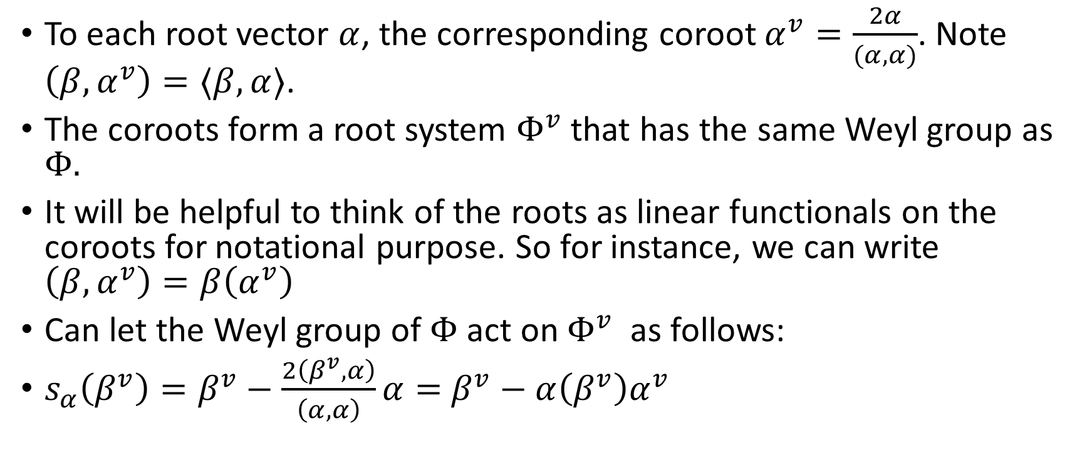
Coroots
To each root vector $α$, the corresponding coroot $α^{v}=\frac{2α}{(α,α)}$. Note $\left(β,α^{v}\right)=⟨β,α⟩$.
The coroots form a root system $Φ^{v}$ that has the same Weyl group as $Φ.$
It will be helpful to think of the roots as linear functionals on the coroots for notational purpose. So for instance, we can write $\left(β,α^{v}\right)=β\left(α^{v}\right)$
Can let the Weyl group of $Φ$ act on $Φ^{v}$ as follows:
$s_{α}\left(β^{v}\right)=β^{v}−\frac{2\left(β^{v},α\right)}{\left(α, α\right)}α=$ $β^{v}−α\left(β^{v}\right)α^{v}$

Slide 7
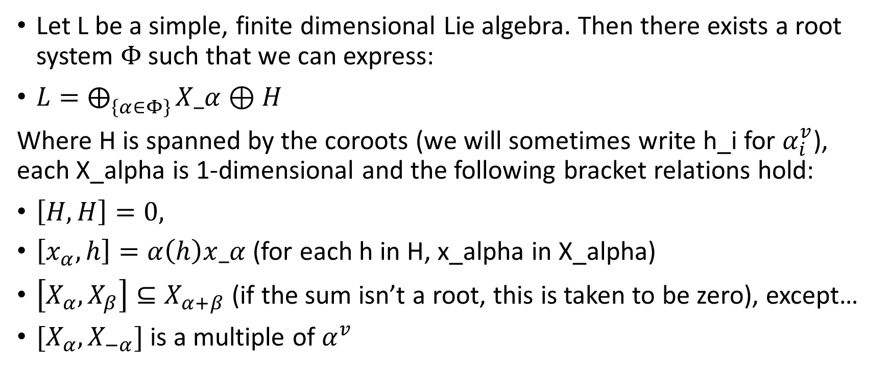
Connection to Lie algebras
Let L be a simple, finite dimensional Lie algebra. Then there exists a root system $Φ$ such that we can express:
$L=⨁_{\left\{α∈Φ\right\}}{X_α}⊕H$
Where H is spanned by the coroots (we will sometimes write h_i for $α_{i}^{v}$), each X_alpha is 1-dimensional and the following bracket relations hold:
$\left[H,H\right]=0,$
$\left[x_{α},h\right]=α\left(h\right)x_α$ (for each h in H, x_alpha in X_alpha)
$\left[X_{α},X_{β}\right]⊆X_{α+β}$ (if the sum isn’t a root, this is taken to be zero), except…
$[X_{α}, X_{−α}]$ is a multiple of $α^{v}$

Slide 8
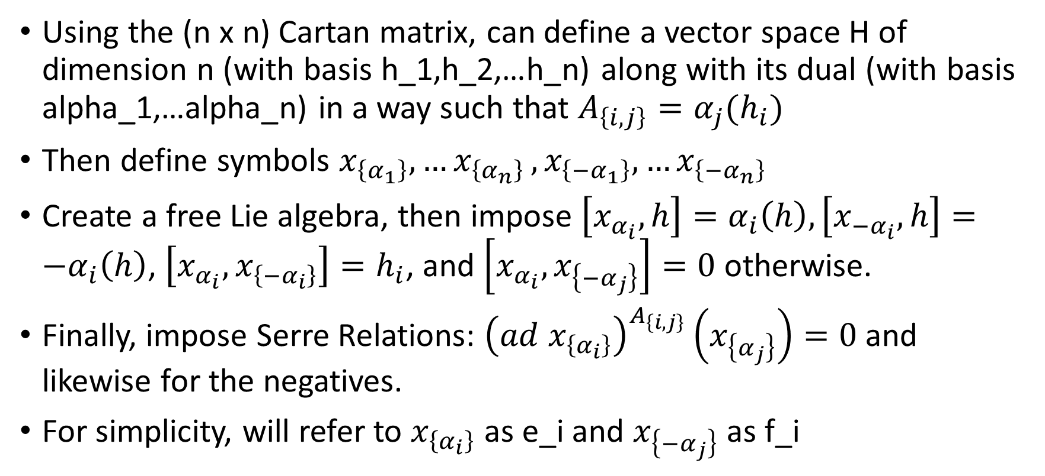
Constructing a Lie algebra from a Cartan matrix
Using the (n x n) Cartan matrix, can define a vector space H of dimension n (with basis h_1,h_2,…h_n) along with its dual (with basis alpha_1,…alpha_n) in a way such that $A_{\left\{i,j\right\}}=α_{j}(h_{i})$
Then define symbols $x_{\left\{α_{1}\right\}},{…x}_{\left\{α_{n}\right\}},x_{\left\{{−α}_{1}\right\}},{…x}_{\left\{−α_{n}\right\}}$
Create a free Lie algebra, then impose $\left[x_{α_{i}},h\right]=α_{i}\left(h\right),\left[x_{−α_{i}},h\right]={−α}_{i}\left(h\right)$, $\left[x_{α_{i}},x_{\left\{−α_{i}\right\}}\right]=h_{i}$, and $\left[x_{α_{i}},x_{\left\{−α_{j}\right\}}\right]=0$ otherwise.
Finally, impose Serre Relations: ${\left(ad x_{\left\{α_{i}\right\}}\right)}_{}^{A_{\left\{i,j\right\}}}\left(x_{\left\{α_{j}\right\}}\right)=0$ and likewise for the negatives.
For simplicity, will refer to $x_{\left\{α_{i}\right\}}$ as e_i and $x_{\left\{−α_{j}\right\}}$ as f_i

Slide 9
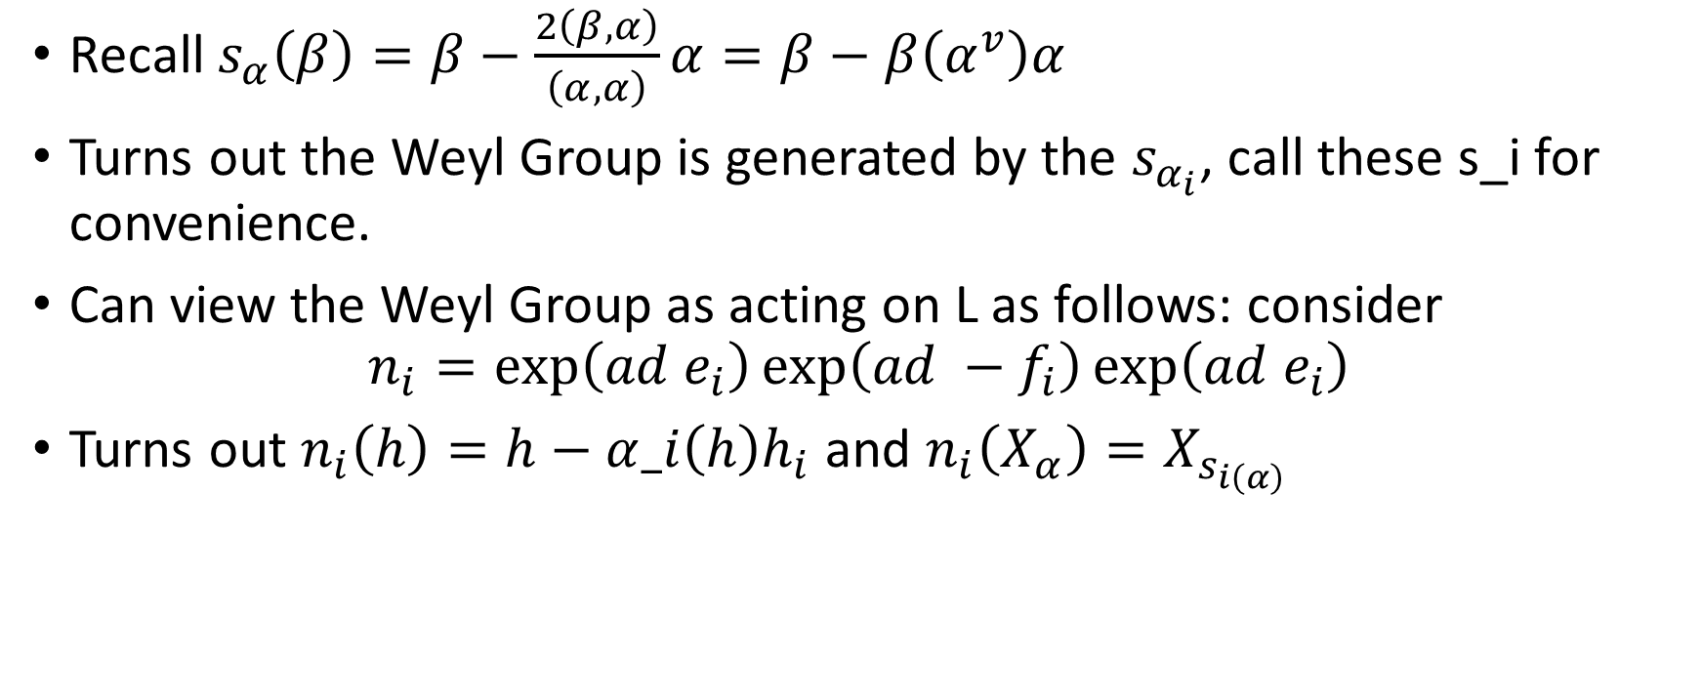
The Weyl Group on L
Recall $s_{α}\left(β\right)=β−\frac{2\left(β,α\right)}{\left(α, α\right)}α=β−β\left(α^{v}\right)α$
Turns out the Weyl Group is generated by the $s_{α_{i}}$, call these s_i for convenience.
Can view the Weyl Group as acting on L as follows: consider
$$n_{i}=\exp\left(ad e_{i}\right)\exp\left(ad −f_{i}\right)\exp\left(ad e_{i}\right)$$
Turns out $n_{i}\left(h\right)=h−α_i\left(h\right)h_{i}$ and $n_{i}\left(X_{α}\right)=X_{s_{i\left(α\right)}}$

Slide 10
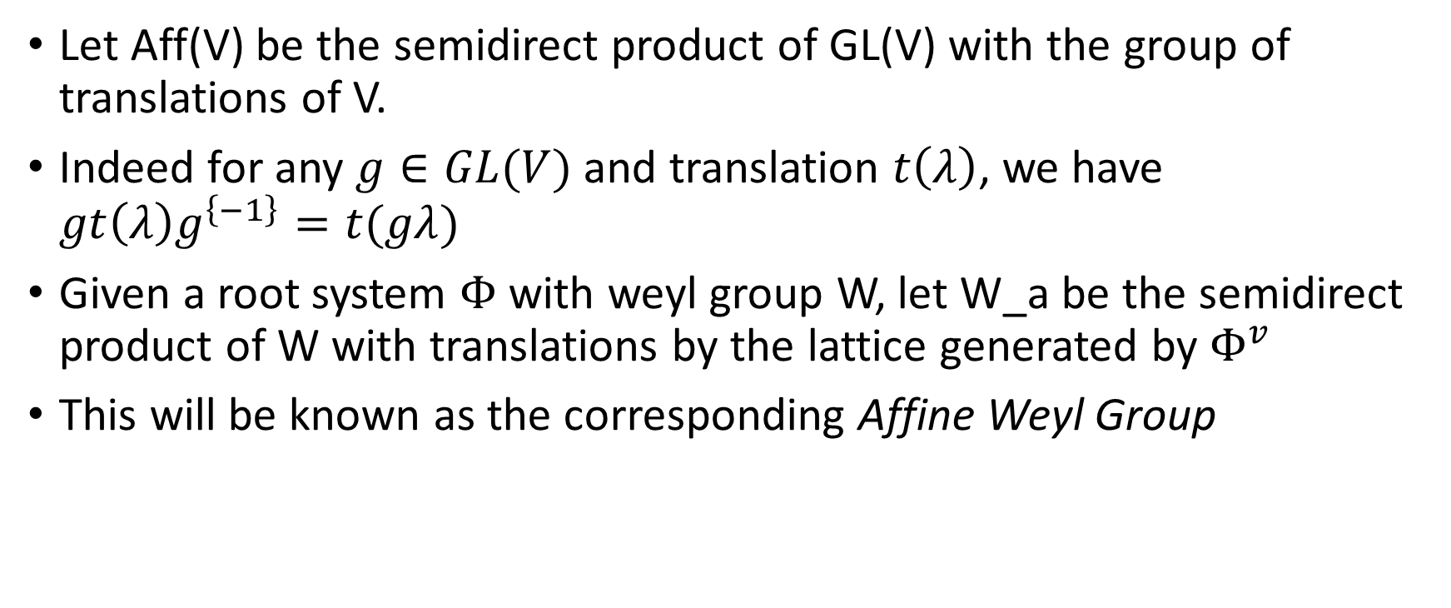
In a completely different direction: Affine Space
Let Aff(V) be the semidirect product of GL(V) with the group of translations of V.
Indeed for any $g∈GL(V)$ and translation $t\left(λ\right)$, we have $gt\left(λ\right)g^{\left\{−1\right\}}=t(gλ)$
Given a root system $Φ$ with weyl group W, let W_a be the semidirect product of W with translations by the lattice generated by $Φ^{v}$
This will be known as the corresponding Affine Weyl Group

Slide 11
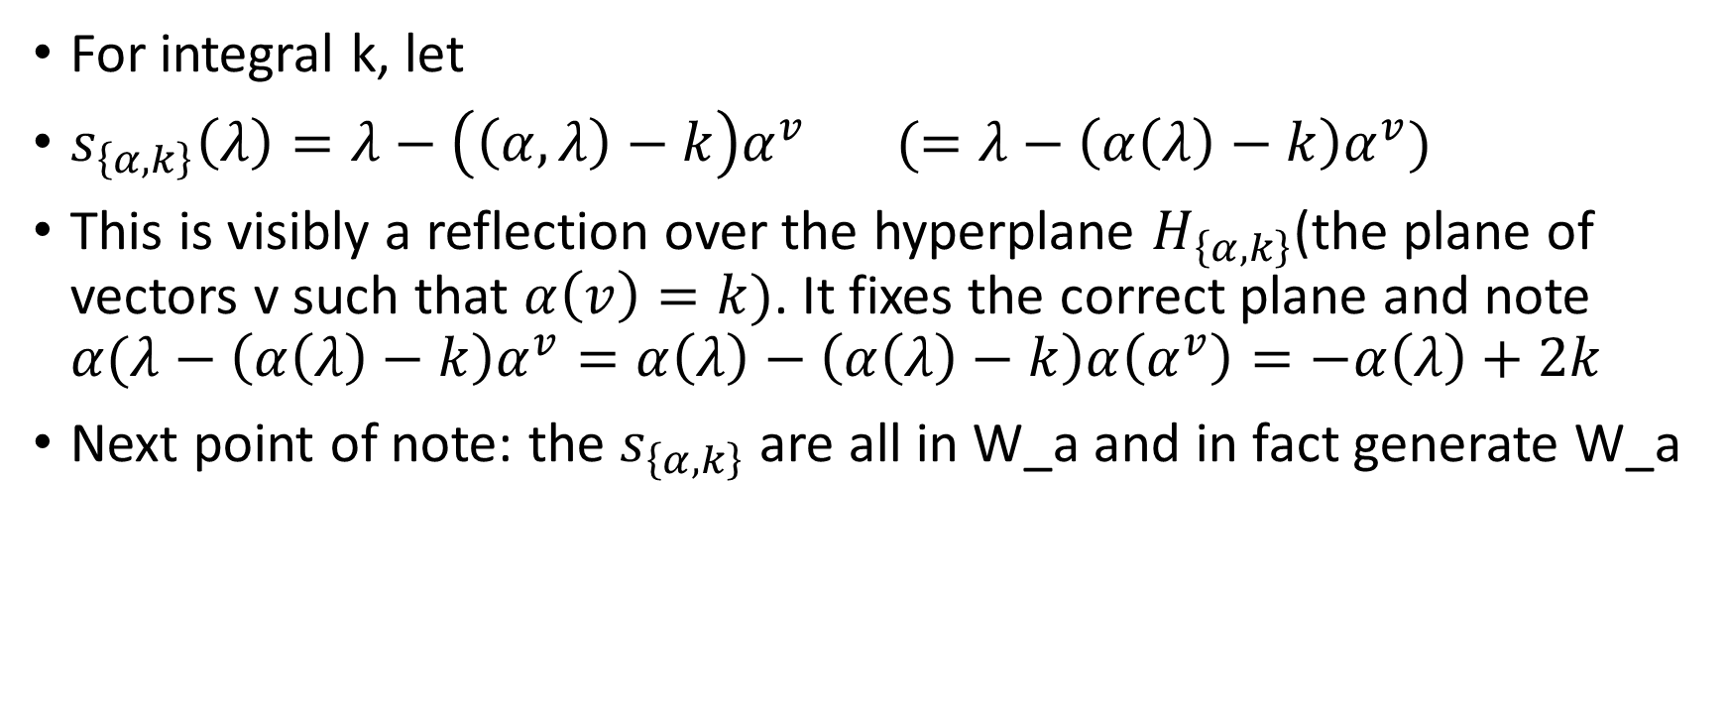
Affine reflections
For integral k, let
$s_{\left\{α,k\right\}}\left(λ\right)=λ−\left(\left(α,λ\right)−k\right)α^{v} (=λ−\left(α\left(λ\right)−k\right)α^{v})$
This is visibly a reflection over the hyperplane $H_{\left\{α,k\right\}}$(the plane of vectors v such that $α\left(v\right)=k)$. It fixes the correct plane and note $α(λ−\left(α\left(λ\right)−k\right)α^{v}=α\left(λ\right)−\left(α\left(λ\right)−k\right)α\left(α^{v}\right)=−α\left(λ\right)+2k$
Next point of note: the $s_{\left\{α,k\right\}}$ are all in W_a and in fact generate W_a

Slide 12

Not too difficult:
First verify that $s_{\left\{α,k\right\}}=t\left(kα^{v}\right)s_α$. Thus they are all in W_a. Then to show they generate, note that this means $s_{\left\{α,k\right\}}s_{α}=t\left(kα^{v}\right)$
From here, our goal will be to show that W_a is actually generated by the $s_{i}$ and $s_{\left\{θ, 1\right\}}$

Slide 13
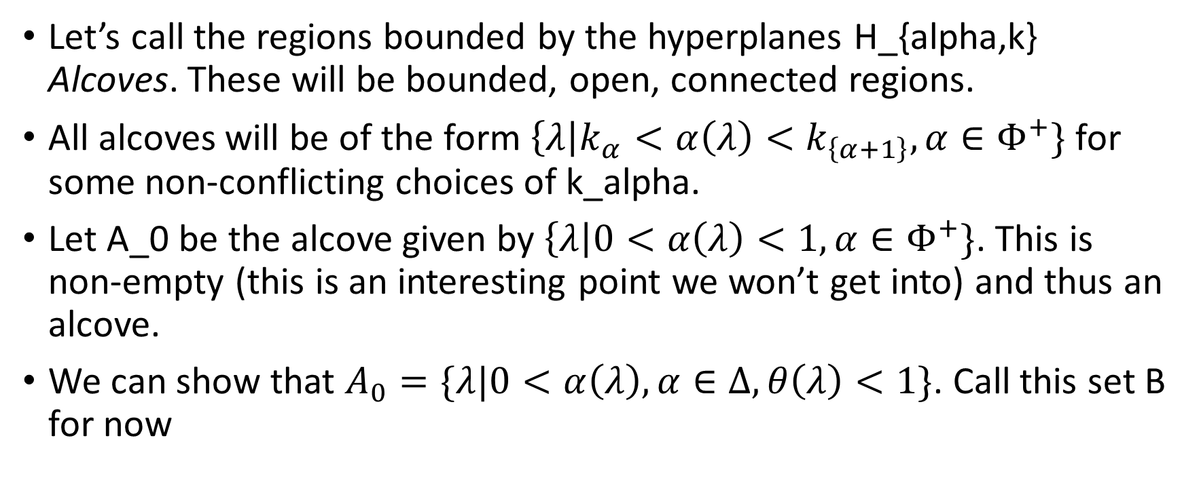
Alcoves
Let’s call the regions bounded by the hyperplanes H_{alpha,k} Alcoves. These will be bounded, open, connected regions.
All alcoves will be of the form $\left\{λ\right|k_{α}<α\left(λ\right)<k_{\left\{α+1\right\}}, α∈Φ^{+}\}$ for some non-conflicting choices of k_alpha.
Let A_0 be the alcove given by $\left\{λ\right|0<α\left(λ\right)<1, α∈Φ^{+}\}$. This is non-empty (this is an interesting point we won’t get into) and thus an alcove.
We can show that $A_{0}=\{λ|0<α\left(λ\right), α∈Δ, θ\left(λ\right)<1\}$. Call this set B for now

Slide 14
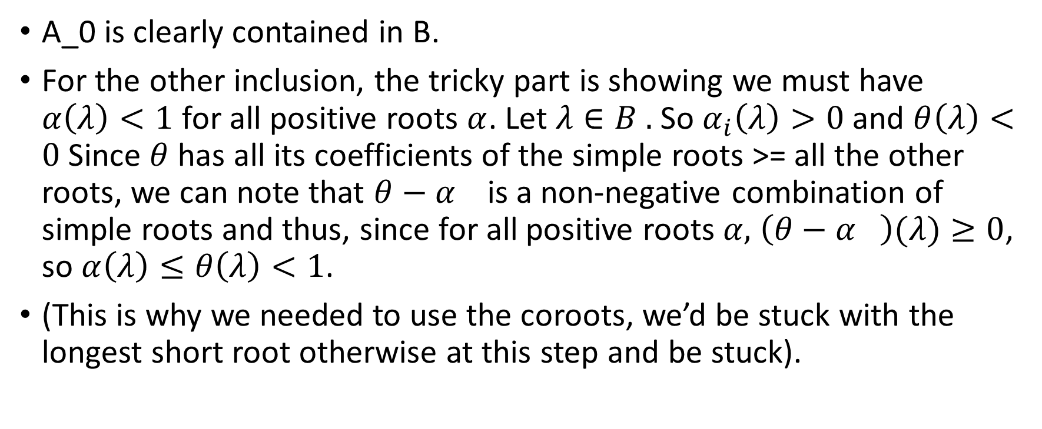
Alcoves
A_0 is clearly contained in B.
For the other inclusion, the tricky part is showing we must have $α\left(λ\right)<1$ for all positive roots $α$. Let $λ∈B .$ So $α_{i}\left(λ\right)>0$ and $θ\left(λ\right)<0$Since $θ$ has all its coefficients of the simple roots >= all the other roots, we can note that $θ−α_{}$ is a non-negative combination of simple roots and thus, since for all positive roots $α,$ $\left(θ−α_{}\right)(λ)≥0$, so $α\left(λ\right)≤θ\left(λ\right)<1$.
(This is why we needed to use the coroots, we’d be stuck with the longest short root otherwise at this step and be stuck).

Slide 15
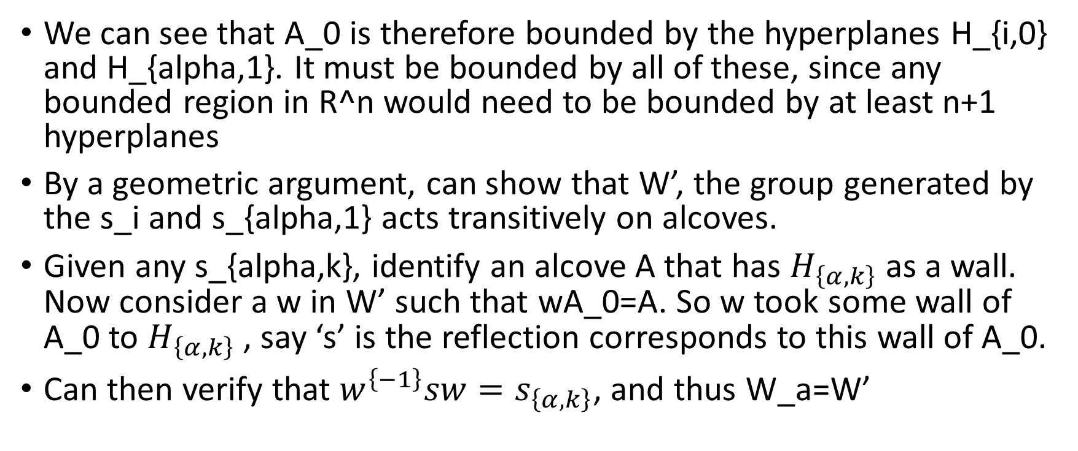
Alcoves
We can see that A_0 is therefore bounded by the hyperplanes H_{i,0} and H_{alpha,1}. It must be bounded by all of these, since any bounded region in R^n would need to be bounded by at least n+1 hyperplanes
By a geometric argument, can show that W’, the group generated by the s_i and s_{alpha,1} acts transitively on alcoves.
Given any s_{alpha,k}, identify an alcove A that has $H_{\left\{α,k\right\}}$as a wall. Now consider a w in W’ such that wA_0=A. So w took some wall of A_0 to $H_{\left\{α,k\right\}}$, say ‘s’ is the reflection corresponds to this wall of A_0.
Can then verify that $w^{\left\{−1\right\}}sw=s_{\left\{α,k\right\}}$, and thus W_a=W’

Slide 16
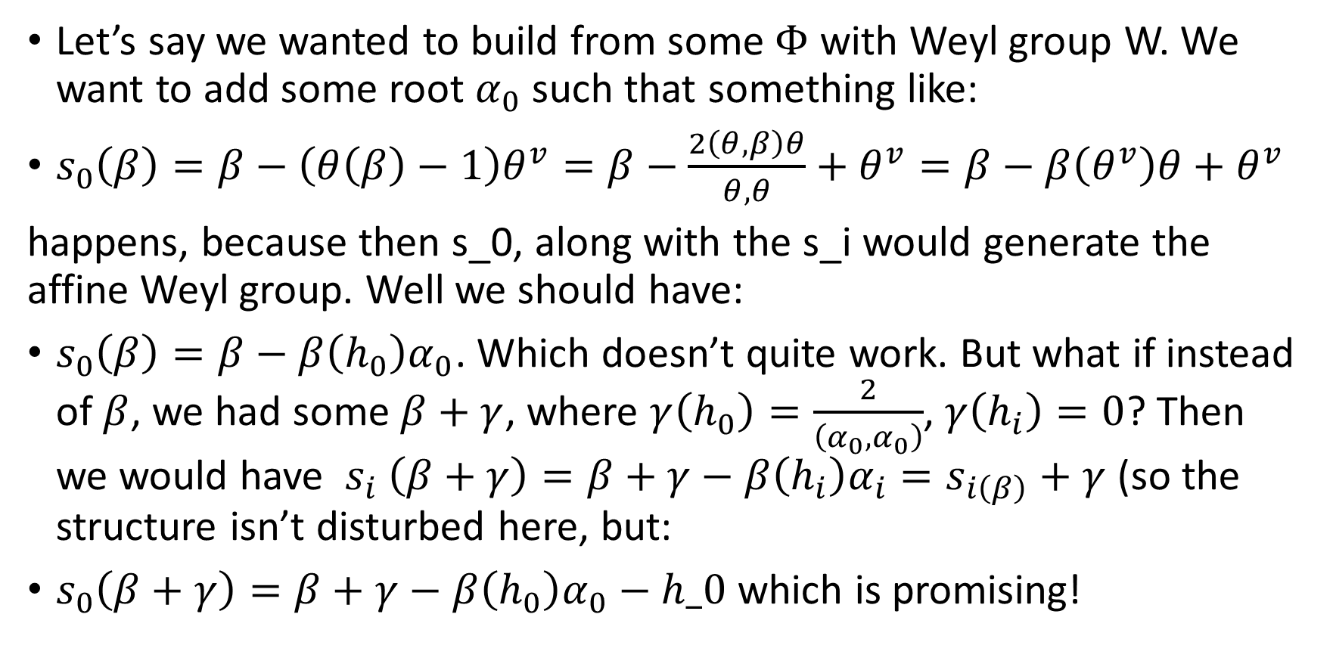
Can we build a kind of root system whose Weyl group looks like an affine Weyl group?
Let’s say we wanted to build from some $Φ$ with Weyl group W. We want to add some root $α_{0}$ such that something like:
$s_{0}\left(β\right)=β−\left(θ\left(β\right)−1\right)θ^{v}=β−\frac{2\left(θ,β\right)θ}{θ,θ}+θ^{v}=β−β\left(θ^{v}\right)θ+θ^{v}$
happens, because then s_0, along with the s_i would generate the affine Weyl group. Well we should have:
$s_{0}\left(β\right)=β−β\left(h_{0}\right)α_{0}$. Which doesn’t quite work. But what if instead of $β$, we had some $β+γ$, where $γ\left(h_{0}\right)=\frac{2}{\left(α_{0},α_{0}\right)}$, $γ\left(h_{i}\right)=0$? Then we would have $s_{i} \left(β+γ\right)=β+γ−β\left(h_{i}\right)α_{i}=s_{i\left(β\right)}+γ$ (so the structure isn’t disturbed here, but:
$s_{0}\left(β+γ\right)=β+γ−β\left(h_{0}\right)α_{0}−h_0$ which is promising!

Slide 17
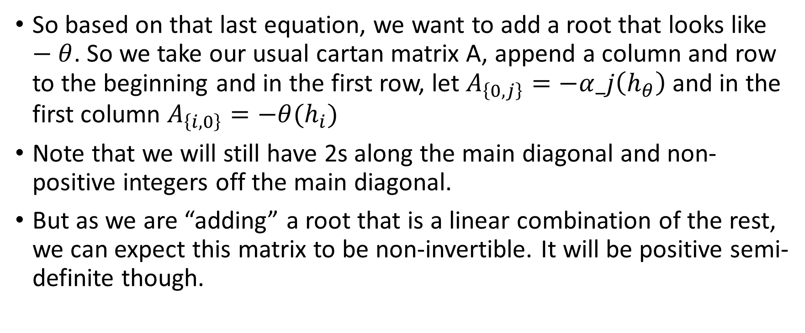
Constructing the (untwisted) affine Cartan matrix
So based on that last equation, we want to add a root that looks like $−θ$. So we take our usual cartan matrix A, append a column and row to the beginning and in the first row, let $A_{\left\{0,j\right\}}=−α_j\left(h_{θ}\right)$ and in the first column $A_{\left\{i,0\right\}}=−θ(h_{i})$
Note that we will still have 2s along the main diagonal and non-positive integers off the main diagonal.
But as we are “adding” a root that is a linear combination of the rest, we can expect this matrix to be non-invertible. It will be positive semi-definite though.

Slide 18
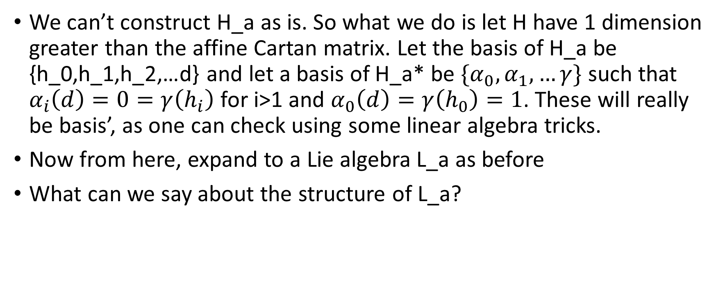
We would like to construct a Lie algebra from this Affine Cartan matrix, but we must fix this non-invertibility issue
We can’t construct H_a as is. So what we do is let H have 1 dimension greater than the affine Cartan matrix. Let the basis of H_a be {h_0,h_1,h_2,…d} and let a basis of H_a* be $\{α_{0},α_{1},…γ\}$ such that $α_{i}\left(d\right)=0=γ\left(h_{i}\right)$ for i>1 and $α_{0}\left(d\right)=γ\left(h_{0}\right)=1$. These will really be basis’, as one can check using some linear algebra tricks.
Now from here, expand to a Lie algebra L_a as before
What can we say about the structure of L_a?

Slide 19
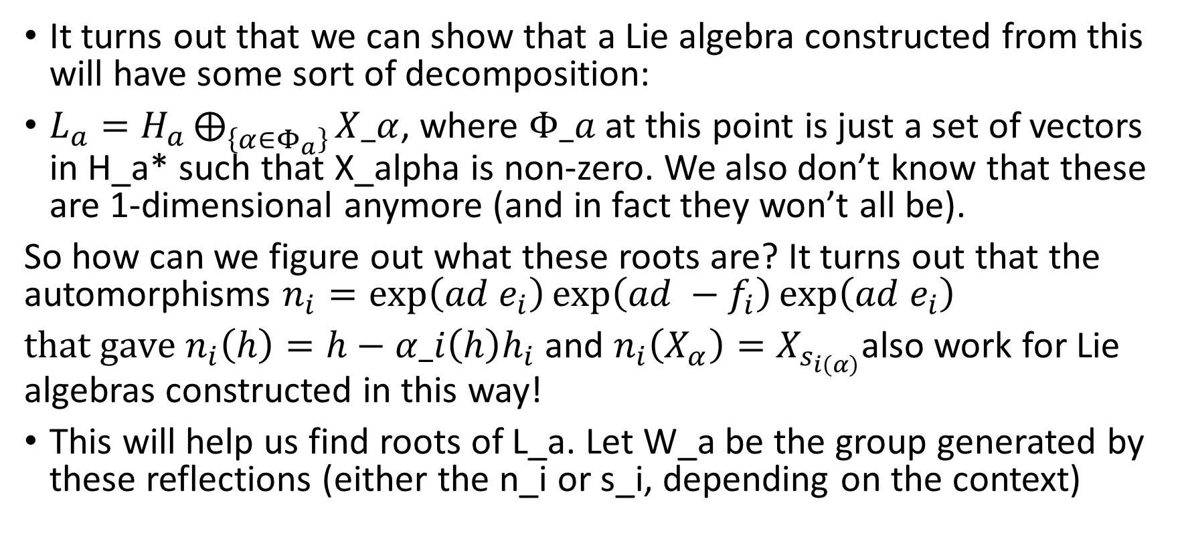
Roots of L_a
It turns out that we can show that a Lie algebra constructed from this will have some sort of decomposition:
$L_{a}=H_{a}⨁_{\left\{α∈Φ_{a}\right\}}{X_α}$, where $Φ_a$ at this point is just a set of vectors in H_a* such that X_alpha is non-zero. We also don’t know that these are 1-dimensional anymore (and in fact they won’t all be).
So how can we figure out what these roots are? It turns out that the automorphisms $n_{i}=\exp\left(ad e_{i}\right)\exp\left(ad −f_{i}\right)\exp\left(ad e_{i}\right)$
$that gave n_{i}\left(h\right)=h−α_i\left(h\right)h_{i}$ and $n_{i}\left(X_{α}\right)=X_{s_{i\left(α\right)}}$also work for Lie algebras constructed in this way!
This will help us find roots of L_a. Let W_a be the group generated by these reflections (either the n_i or s_i, depending on the context)

Slide 20
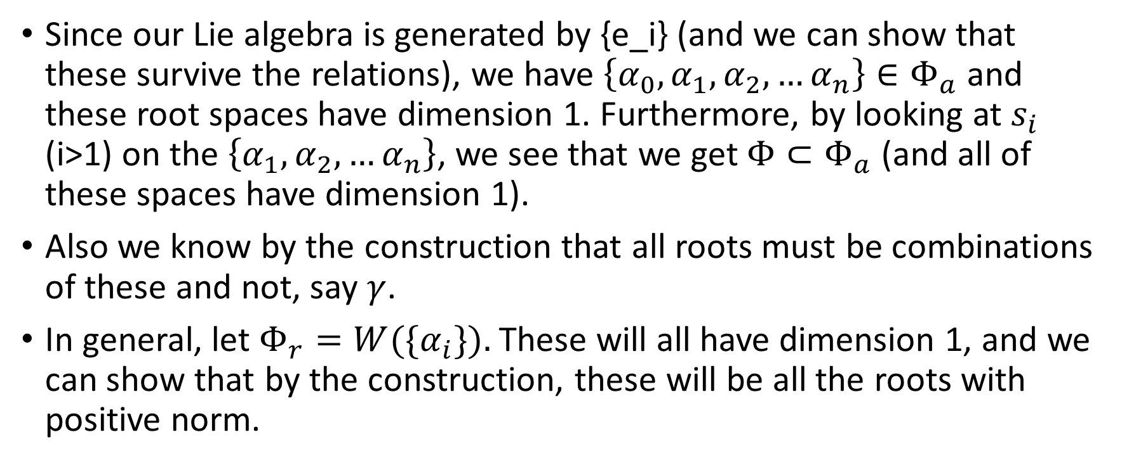
Starting it off…
Since our Lie algebra is generated by {e_i} (and we can show that these survive the relations), we have $\left\{{α_{0},α}_{1},α_{2},…α_{n}\right\}∈Φ_{a}$ and these root spaces have dimension 1. Furthermore, by looking at $s_{i}$ (i>1) on the $\left\{α_{1},α_{2},…α_{n}\right\}$, we see that we get $Φ⊂Φ_{a}$ (and all of these spaces have dimension 1).
Also we know by the construction that all roots must be combinations of these and not, say $γ$.
In general, let $Φ_{r}=W(\{α_{i}\}).$ These will all have dimension 1, and we can show that by the construction, these will be all the roots with positive norm.

Slide 21
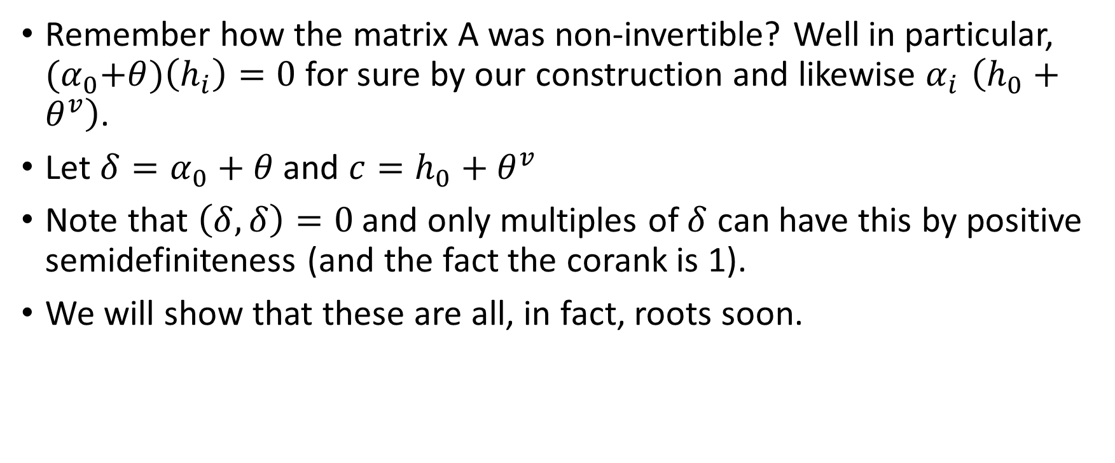
Imaginary roots
Remember how the matrix A was non-invertible? Well in particular, ${(α}_{0}+θ)\left(h_{i}\right)=0$ for sure by our construction and likewise $α_{i }\left(h_{0}+θ^{v}\right)$.
Let $δ=α_{0}+θ$ and $c=h_{0}+θ^{v}$
Note that $\left(δ,δ\right)=0$ and only multiples of $δ$ can have this by positive semidefiniteness (and the fact the corank is 1).
We will show that these are all, in fact, roots soon.

Slide 22
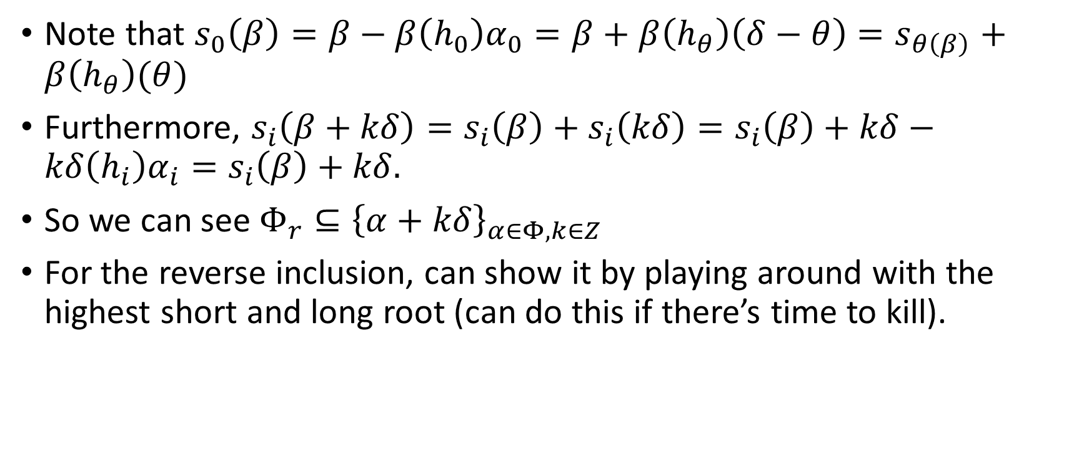
Continuing the root-finding process
Note that $s_{0}\left(β\right)=β−β\left(h_{0}\right)α_{0}=β+β\left(h_{θ}\right)\left(δ−θ\right)=s_{θ\left(β\right)}+β\left(h_{θ}\right)(θ)$
Furthermore, $s_{i}\left(β+kδ\right)=s_{i}\left(β\right)+s_{i}\left(kδ\right)=s_{i}\left(β\right)+kδ−kδ\left(h_{i}\right)α_{i}=s_{i}\left(β\right)+kδ.$
So we can see $Φ_{r}⊆{\left\{α+kδ\right\}}_{α∈Φ,k∈Z}$
For the reverse inclusion, can show it by playing around with the highest short and long root (can do this if there’s time to kill).

Slide 23
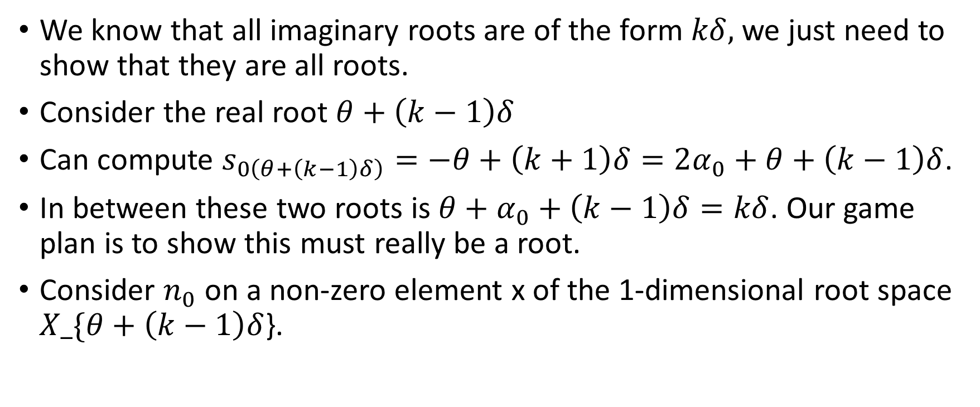
Classifying the imaginary roots
We know that all imaginary roots are of the form $kδ,$ we just need to show that they are all roots.
Consider the real root $θ+\left(k−1\right)δ$
Can compute $s_{0\left(θ+\left(k−1\right)δ\right)}=−θ+\left(k+1\right)δ=2α_{0}+θ+\left(k−1\right)δ$.
In between these two roots is $θ+α_{0}+\left(k−1\right)δ=kδ$. Our game plan is to show this must really be a root.
Consider $n_{0}$ on a non-zero element x of the 1-dimensional root space $X_\{θ+\left(k−1\right)δ$}.

Slide 24
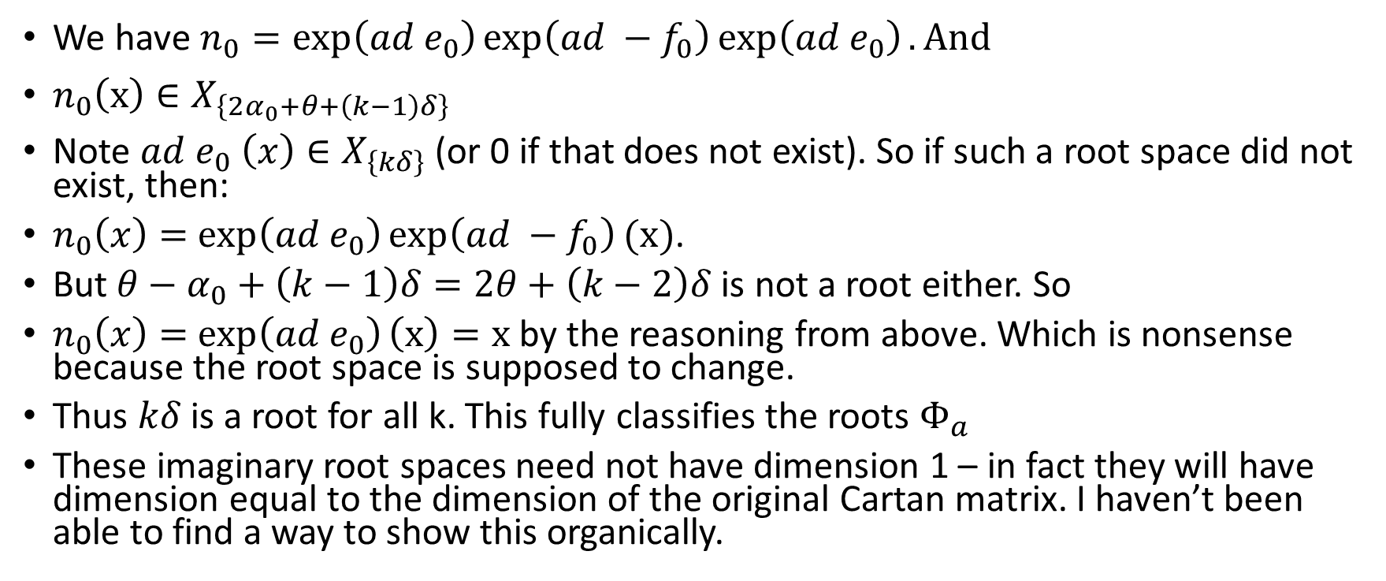
Classifying the imaginary roots
We have $n_{0}=\exp\left(ad e_{0}\right)\exp\left(ad −f_{0}\right)\exp\left(ad e_{0}\right). And$
$n_{0}\left(x\right)∈X_{\left\{2α_{0}+θ+\left(k−1\right)δ\right\}}$
Note $ad e_{0} \left(x\right)∈X_{\left\{kδ\right\}}$ (or 0 if that does not exist). So if such a root space did not exist, then:
$n_{0}\left(x\right)=$ $\exp\left(ad e_{0}\right)\exp\left(ad −f_{0}\right)(x)$.
But $θ−α_{0}+\left(k−1\right)δ=2θ+\left(k−2\right)δ$ is not a root either. So
$n_{0}\left(x\right)=$ $\exp\left(ad e_{0}\right)\left(x\right)=x$ by the reasoning from above. Which is nonsense because the root space is supposed to change.
Thus $kδ$ is a root for all k. This fully classifies the roots $Φ_{a}$
These imaginary root spaces need not have dimension 1 – in fact they will have dimension equal to the dimension of the original Cartan matrix. I haven’t been able to find a way to show this organically.

Slide 25
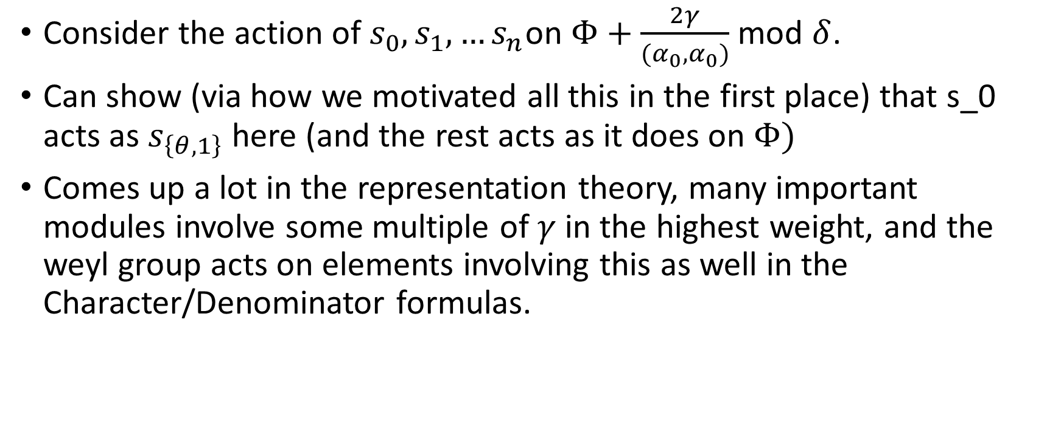
Back to the reason we were doing this in the first place
Consider the action of $s_{0},s_{1},…s_{n}$on $Φ+\frac{2γ}{{(α}_{0},α_{0})}$ mod $δ$.
Can show (via how we motivated all this in the first place) that s_0 acts as $s_{\left\{θ,1\right\}}$ here (and the rest acts as it does on $Φ)$
Comes up a lot in the representation theory, many important modules involve some multiple of $γ$ in the highest weight, and the weyl group acts on elements involving this as well in the Character/Denominator formulas.

Slide 26
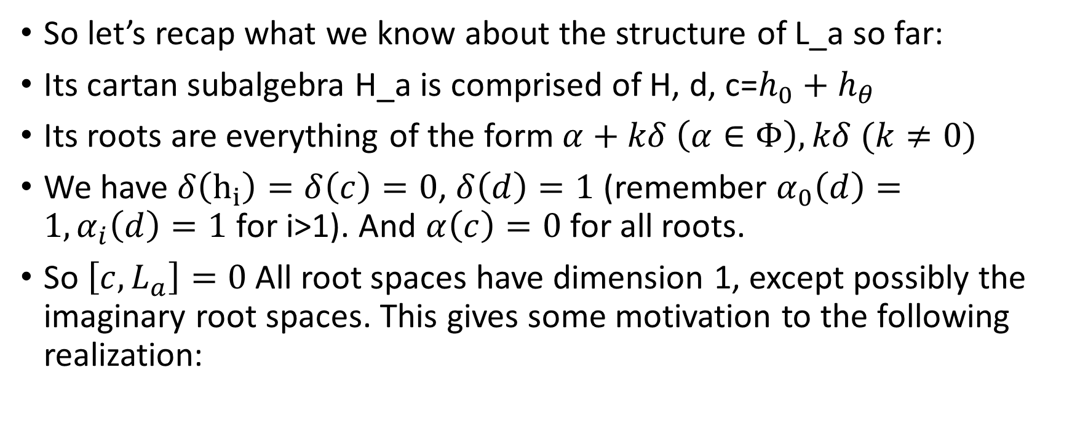
Realization of untwisted affine Lie algebras
So let’s recap what we know about the structure of L_a so far:
Its cartan subalgebra H_a is comprised of H, d, c=$h_{0}+h_{θ}$
Its roots are everything of the form $α+kδ \left(α∈Φ\right), kδ (k≠0)$
We have $δ\left(h_{i}\right)=δ\left(c\right)=0$, $δ\left(d\right)=1$ (remember $α_{0}\left(d\right)=1, α_{i}\left(d\right)=1$ for i>1). And $α\left(c\right)=0$ for all roots.
So $\left[c,L_{a}\right]=0$ All root spaces have dimension 1, except possibly the imaginary root spaces. This gives some motivation to the following realization:

Slide 27
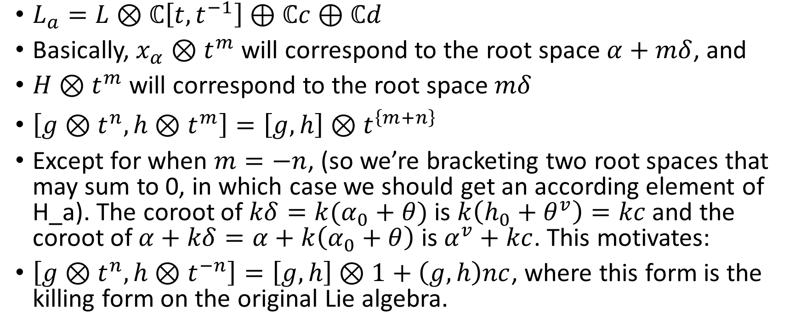
Realization of untwisted affine Lie algebras
$L_{a}=L⊗ℂ\left[t,t^{−1}\right]⊕ℂc⊕$ $ℂd$
Basically, $x_{α}⊗t^{m}$ will correspond to the root space $α+mδ$, and
$H⊗t^{m}$ will correspond to the root space $mδ$
$\left[g⊗t^{n},h⊗t^{m}\right]=\left[g,h\right]⊗t^{\left\{m+n\right\}}$
Except for when $m=−n$, (so we’re bracketing two root spaces that may sum to 0, in which case we should get an according element of H_a). The coroot of $kδ=k(α_{0}+θ)$ is $k\left(h_{0}+θ^{v}\right)=kc$ and the coroot of $α+kδ=α+k\left(α_{0}+θ\right)$ is $α^{v}+kc$. This motivates:
$\left[g⊗t^{n},h⊗t^{−n}\right]=\left[g,h\right]⊗1+\left(g,h\right)nc$, where this form is the killing form on the original Lie algebra.

Slide 28

Realization of untwisted affine Lie algebras
Finally, reflecting $δ\left(d\right)=1$, we have
$\left[d,g⊗t^{n}\right]=ng⊗t^{n}$
And c is central.

